Slide 1
Town Ball
Depression-era Baseball in the Texas Hill Country
Book scheduled for publication: September 2026
Texas Tech University Press
Richard W. Butler Jr.
© 2026

Slide 2
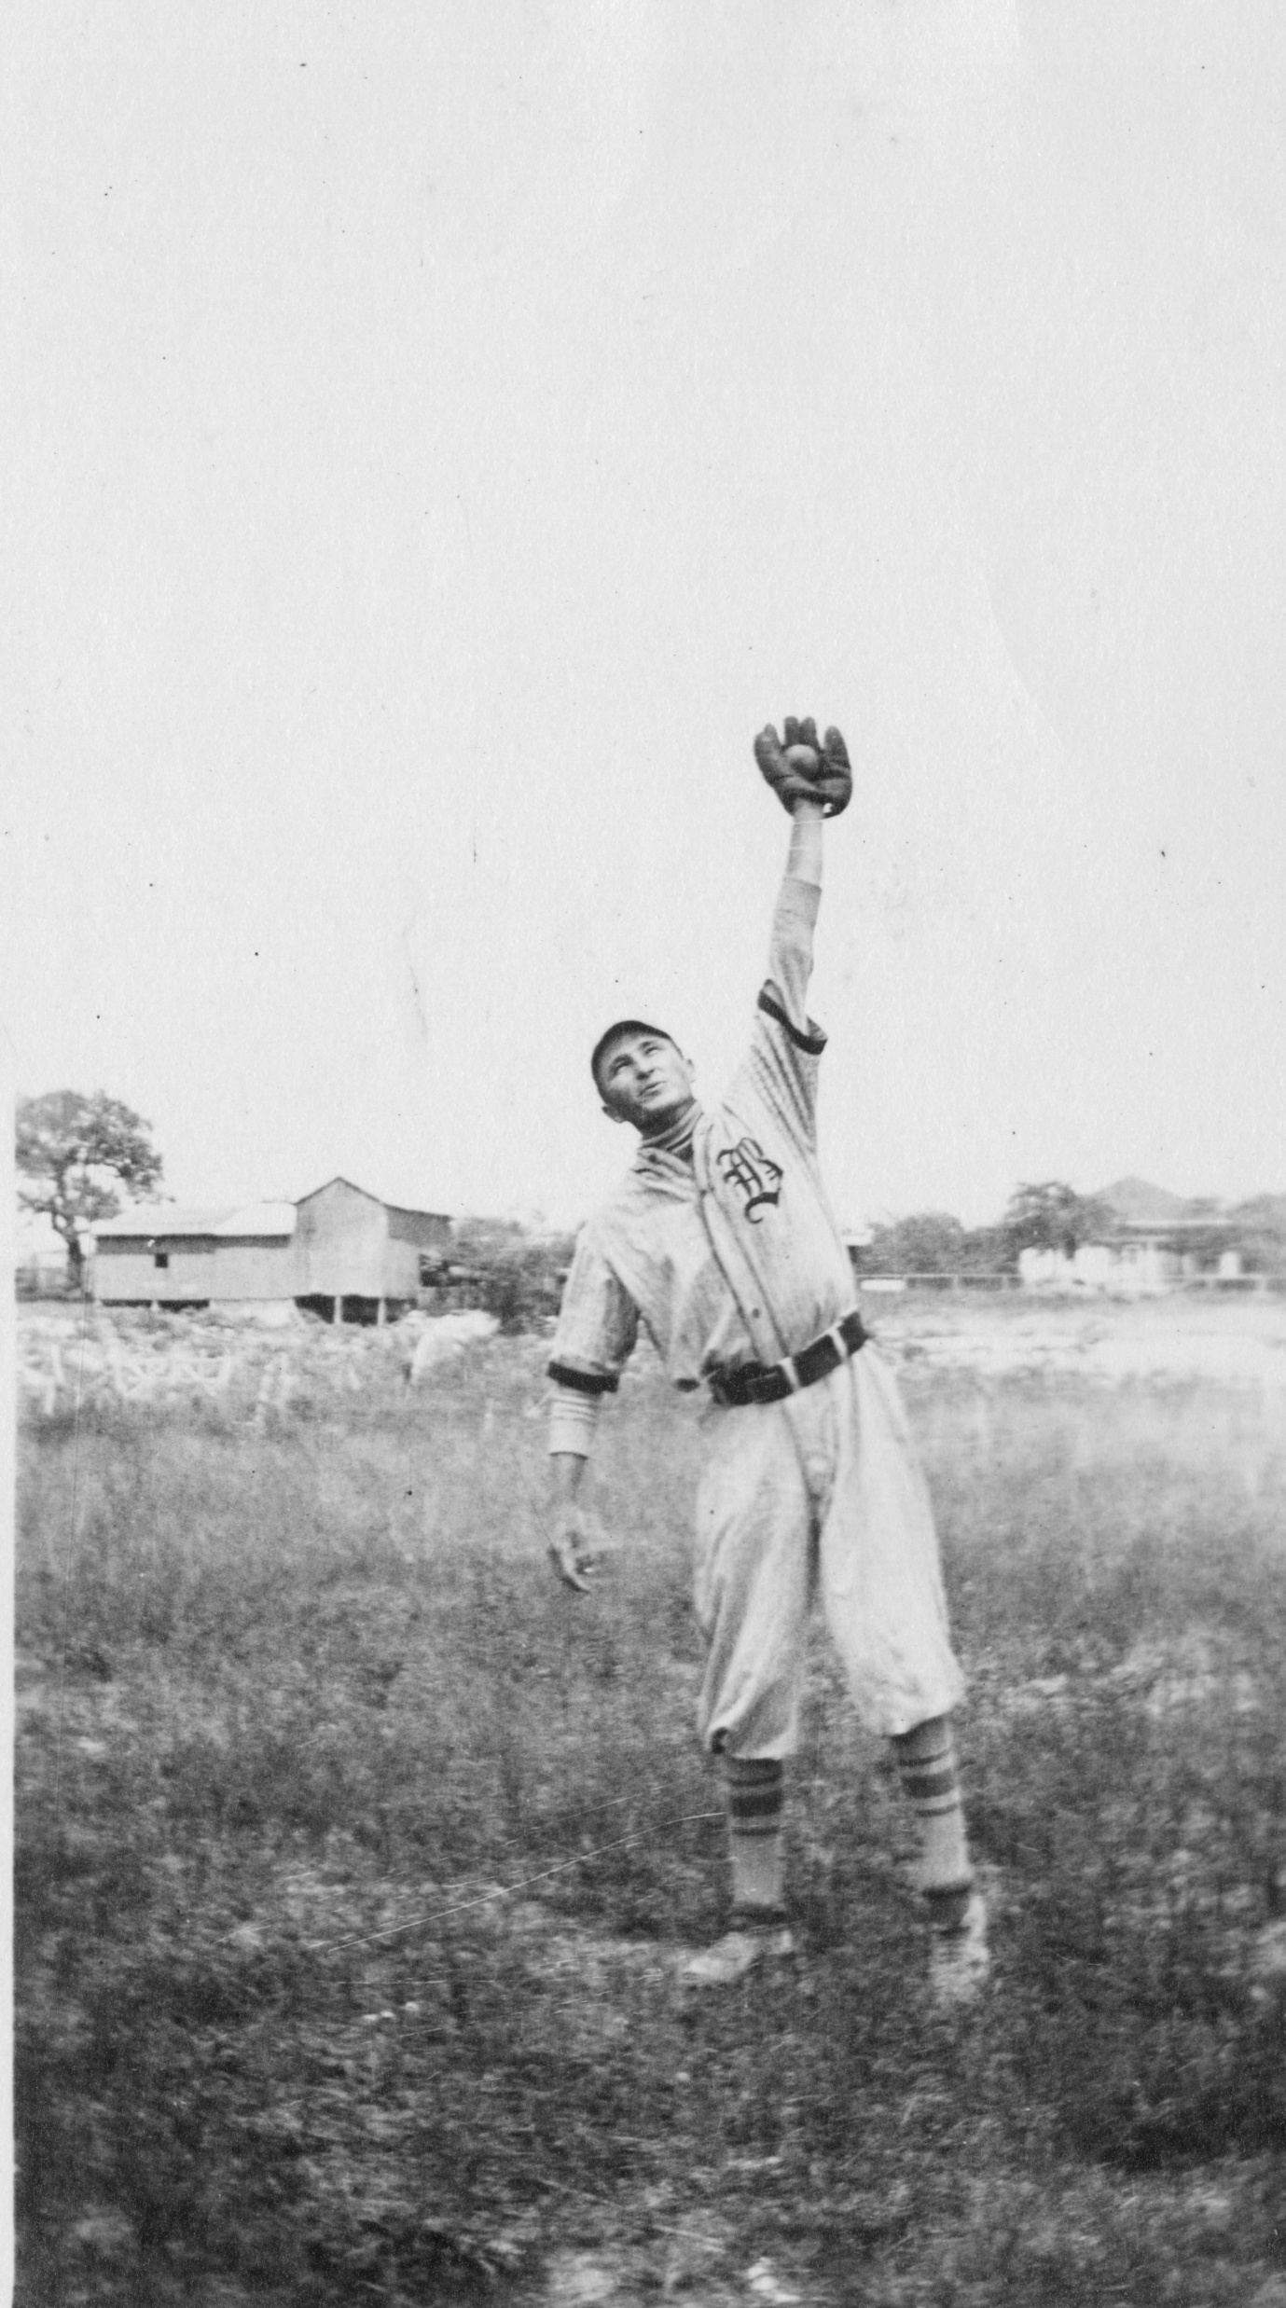
Town Ball

Slide 3
Town Ball
Topics
Brief history of Texas baseball
Town teams develop as Hill Country Germans embraced baseball
What is town baseball?
Hill Country League and Mountain League, 1930s
Major leaguers (former and future) who played in the Hill Country
Kerrville Black town baseball
Wrap Up

Slide 4
Town Ball
Intro/Author Background
SABR member since 1983
Moved to Boerne 2022
Journey began with visit to Old Jail Museum/Boerne White Sox photo and review of the Boerne White Sox file at the Boerne library.

Slide 5
Town Ball
Baseball Comes to Texas & Hill Country
Civil War brought baseball to Texas & the South through POWs
First game in Texas, 1867 in Galveston
Role of Abner Doubleday with Freedman’s Bureau in Galveston?
Baseball moved west, came to German settlers in Hill Country

Slide 6
Town Ball
German Culture
Germans loved “organized fun,” German traditions of Vereine (clubs, associations)
Examples:
Gesangverein (singing club)
Turnverein (bowling club)
Schuetzenverein (shooting club)

Slide 7
Town Ball
Baseball as New Verein
Germans embraced baseball, treating the sport as a new Verein.
Germans melded their “club” traditions with baseball, a game unknown in Germany.
Thus, baseball represented both a continuation (German cultural norms) and a departure (assimilation of the primary sport of the new world)
Town teams arose in late 1800s
Baseball games were community-wide events on Sunday afternoons with picnic baskets and lemonade

Slide 8
Town Ball
First Reported Game
1891: Kerrville traveled to Bandera
Final Score: Kerrville __, Bandera __?
The name of Bandera’s shortstop? Loss Carmichael

Slide 9
Town Ball
First Reported Game
1891: Kerrville traveled to Bandera
Final Score: Kerrville 94, Bandera 0
The name of Bandera’s shortstop? Loss Carmichael

Slide 10
Town Ball
Early 1900s
By 1910, baseball had come to every town in the Hill Country
Baseball evolved from occasional Sunday games against other towns to teams playing most Sundays from April through August/September
Fierce rivalries ensued (Fredericksburg-Llano spitball controversy, 1921)
Bragging rights on the line
Baseball was king, baseball games were front page news in town newspapers
No other sport came close to the popularity of baseball

Slide 11
Town Ball
Baseball is no Highbrow Game
Llano News, 1916:
“Baseball is no highbrow game . . . It is the American game, and the Llano boys are going to furnish the Llano fans of the city with thrills such as a certain Ty Cobb furnishes the fans of every big-league city. The Llano boys like the boys of every other town in America, had rather be another Ty Cobb than to be president.”

Slide 12

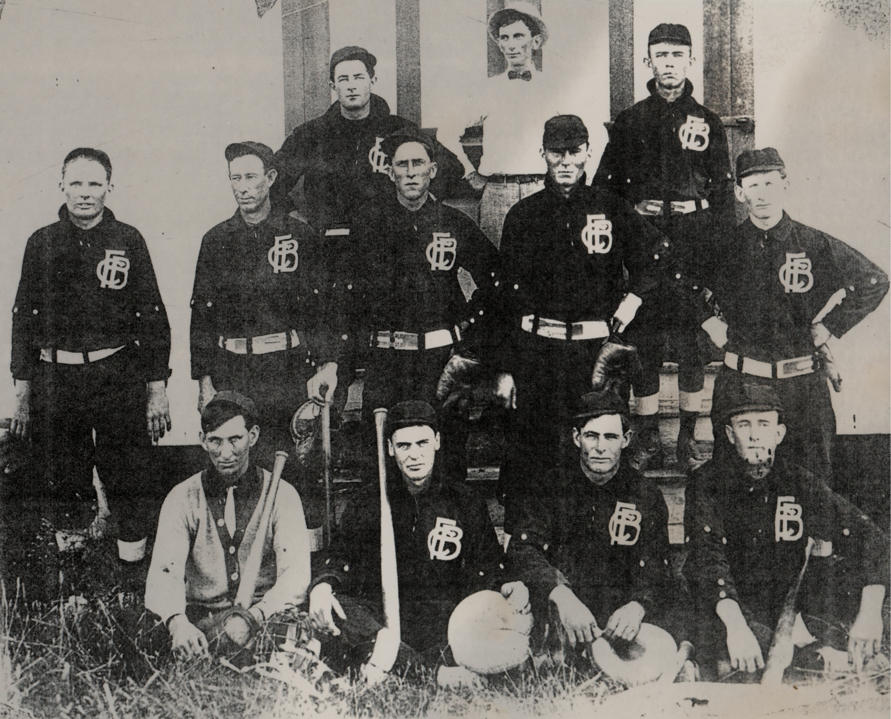
Fredericksburg Giants, 1910

Slide 13
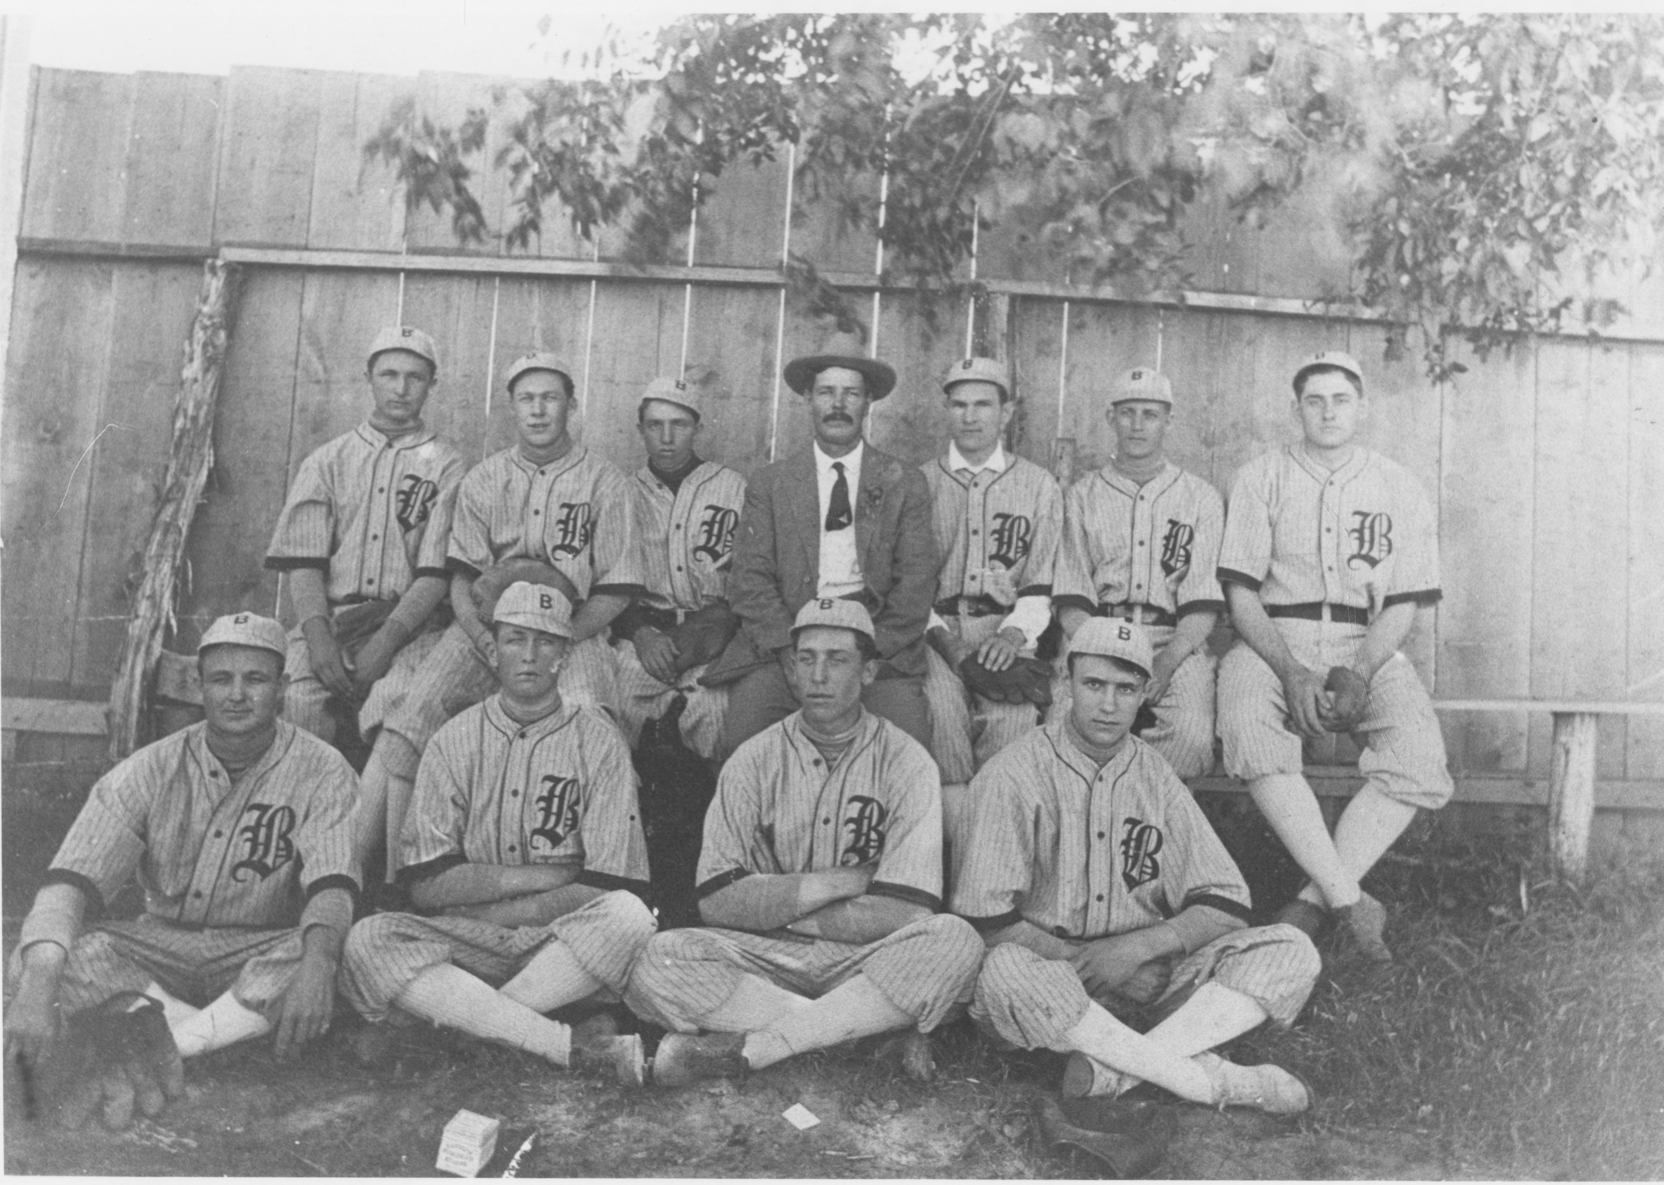
Boerne
White Sox, 1912

Slide 14
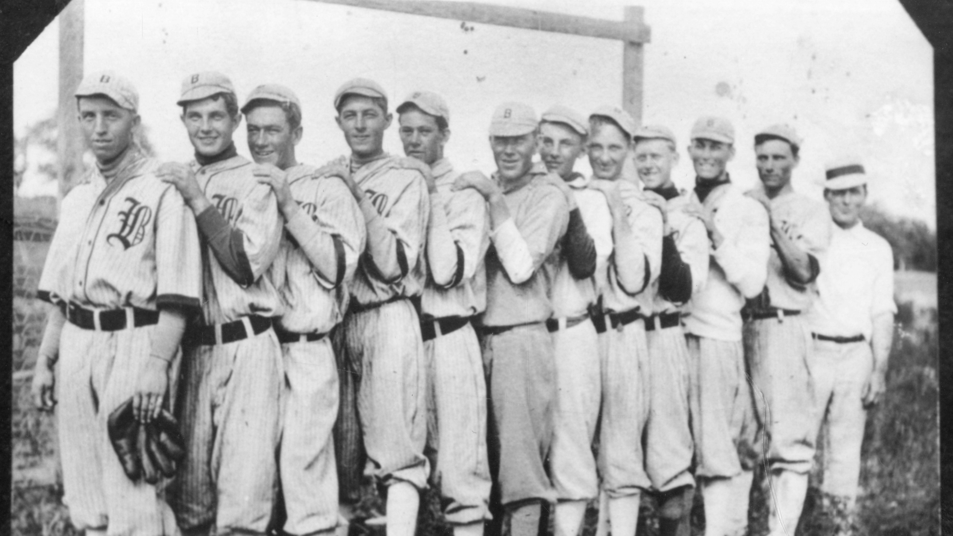
Boerne White Sox, 1914

Slide 15
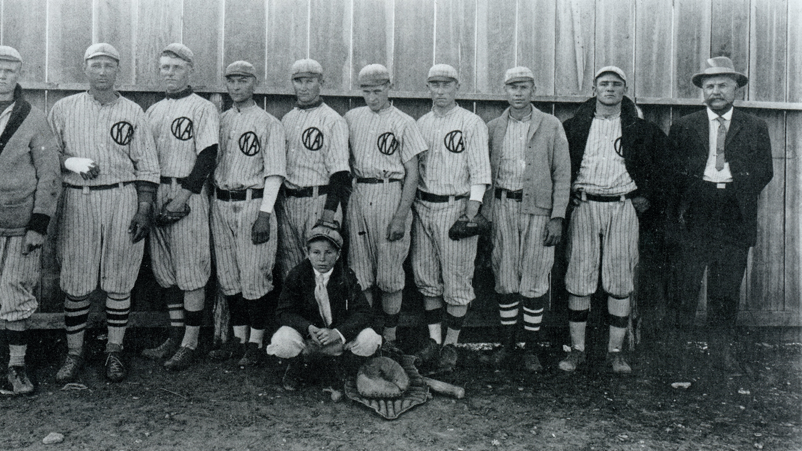
Kerrville Athletics, 1925

Slide 16
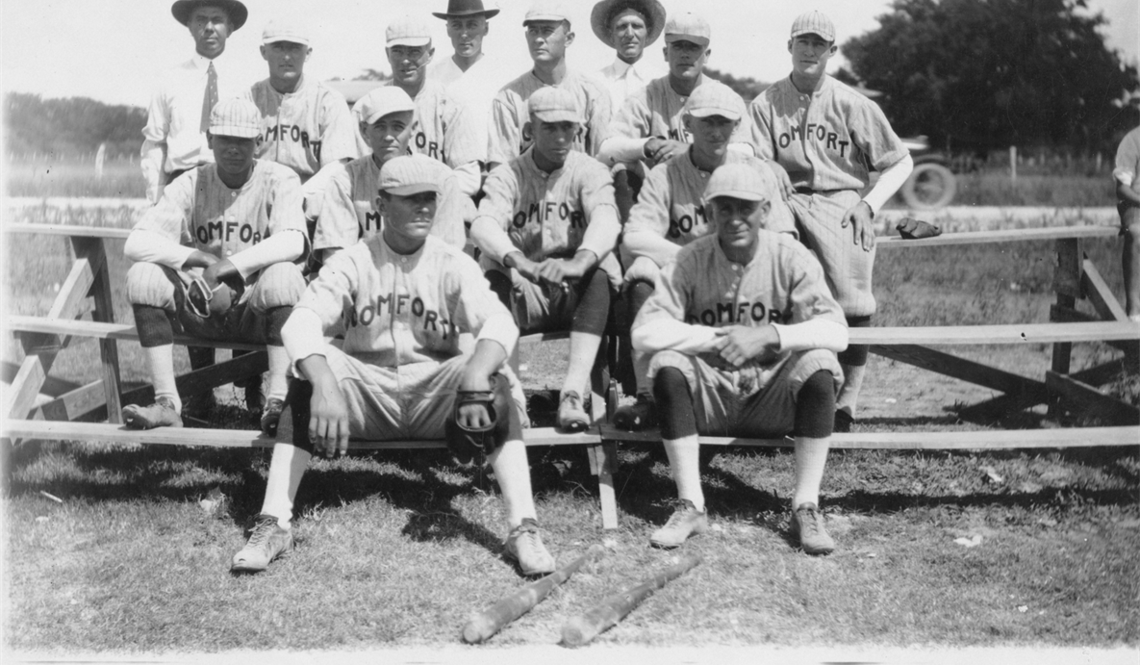
Comfort Broncos, 1922

Slide 17
Town Ball
What is “Town Baseball”?
“House of Baseball” hierarchy, Harold Seymour & Dorothy Seymour Mills, in The People’s Game
Distinction between town baseball and semipro
Players generally played for their hometown
Mostly amateur, but a few paid “ringers” (typically $5 per game)
No “owners” but typically run by an association of local businessmen
No profits; gate revenues (admission 25-40 cents per game in 1930s) covered team expenses such as uniforms, bats, balls, groundskeeping, umpires, league fees, etc.

Slide 18
Town Ball
Town Ballparks:
Capacity: 500-1500
Fredericksburg: Fair Park (inside horse track)
Boerne: Kendall County Fairgrounds (inside horse track)
Kerrville: Corner of McFarland & Paschal (hosted 1930 spring training game between Chicago White Sox and New York Giants)
Comfort: Faltin Field
Llano: Robinson State Park (now a city park)

Slide 19
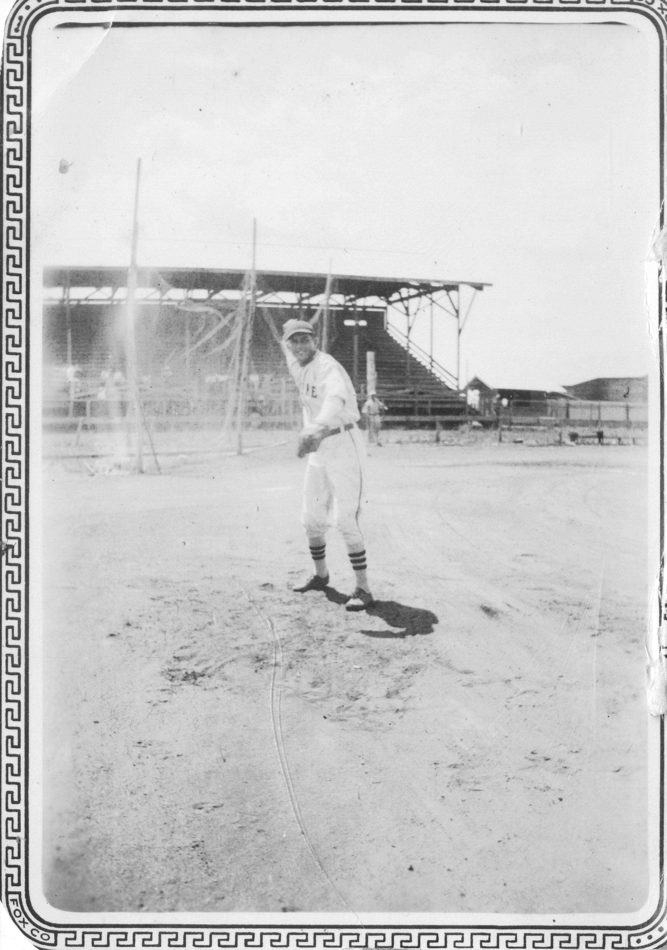
Town Ball
Kendall County Fairgrounds

Slide 20
Town Ball
Family Affair
Fredericksburg: Klaerners (Hugo, Chester, Alfons, Elias, Phillip)
Boerne: Ueckers (Edwin, Albert, Johnny, Tuddy) and Bergmanns (Edgar, Walter)
Comfort: Pankratz (Joe, Skeeter, Manny) plus Pankratz Panthercats, 1948, an all-Pankratz team
Deike Brothers (Hye): All-brother team in 1935: Victor, age 15, outfielder; Emil, 17, third base; Ernest, 21, first base; Clarence, 21, second base; Levi, 23, shortstop (Levi played with the Fredericksburg Giants in 1935); Red, 25, pitcher; Marvin, 28, pitcher-outfielder; Herman, 30, catcher; and Edwin, 33, outfielder.

Slide 21
Town Ball
Glorious Nicknames
Smokey Klaerner
Lefty Draper
Zip Myler
Slim Esbeck
Skeeter Pankratz
Pepper Probst
Flop Bradley
Jelly Harris
Goat Gardner
Chicken Henke
Cheese Bremer

Slide 22
Town Ball
Future Major Leaguers in the Hill Country Before Organized Leagues (1930):
Bibb Falk, outfielder, Fredericksburg Giants, 1918
Dizzy Dean, pitcher, Fort Sam Houston and various Hill Country teams, 1925 (?)-1929
Did Dizzy Dean pitch under an alias as a 15-year-old for the Comfort Broncos in 1925?

Slide 23
Town Ball
First League:
Hill Country League, 1930
Fredericksburg, Llano, Mason, Boerne, Comfort, and Kerrville
26-game schedule
Top two teams played best-of-three championship series

Slide 24
Town Ball
1930 Hill Country League Standings
W L GB Pct.
Fredericksburg 19 7 —- .731
Llano 18 7 ½ .720
Boerne 17 9 2 .654
Kerrville 10 15 8½ .400
Comfort 8 18 11 .308
Mason 5 21 14 .192
Fredericksburg Giants defeated Llano Cowboys in three games to win the inaugural HCL title

Slide 25
Town Ball
Hill Country League, 1931
Boerne dropped out (travel expenses to northern towns), replaced by the Junction Firemen (later the Mountaineers)
Llano initially withdrew, replaced by Pontotoc Pirates, but Pontotoc dropped out after six games
Llano returned to HCL, assuming 3-3 record of Pontotoc

Slide 26
Town Ball
1931 Hill Country League Standings
W L GB Pct.
Fredericksburg 20 6 —- .769
Llano 16 7 2½ .696
Kerrville 13 12 6½ .520
Mason 10 14 9 .417
Comfort 8 15 10½ .348
Junction 6 19 13½ .240
Llano defeated defending champ Fredericksburg in the championship series

Slide 27
Town Ball
Hill Country League, 1932
Comfort dropped out, replaced by Brady Turks.
New playoff system: First and second half winners play in championship series
Llano (9-4, 11-1) defeated Mason Mavericks (10-3, 5-6) for the championship
Blatant use of “outside men” in championship series

Slide 28
Town Ball
1932 Hill Country League Standings-First Half
W L GB Pct.
Mason 10 3 —- .769
Llano 9 4 1 .692
Fredericksburg 8 5 2 .615
Kerrville 6 7 4 .462 .
Brady 5 8 5 .385 .
Junction 1 12 9 .077
1932 Hill Country League Standings-Second Half
W L GB Pct.
Llano 11 1 —- .917
Brady 6 4 4 .600
Fredericksburg 6 5 4½ .545
Mason 5 6 5½ .455
Kerrville 5 7 6 .417 .
Junction 0 10 10 .000

Slide 29
Town Ball
Upheaval and Birth of Mountain League, 1933
After 1932, Kerrville dropped out of the Hill Country League (like Boerne and Comfort, due to travel to northern towns)
Kerrville spearheaded the creation of the Mountain League consisting of five “southern” teams: Kerrville, Boerne, Comfort, Bandera, & Alamo Heights
Mountain League prohibited paid players, imposed county residency requirement

Slide 30
Town Ball
1933 Mountain League Standings
W L GB Pct.
Alamo Heights 12 6 —- .667
Kerrville 10 8 2 .556
Comfort 10 8 2 .556
Boerne 9 9 3 .500
Bandera 4 14 8 .222
Kerrville defeated Comfort in the playoff game for second place “by the margin of a frog’s eyebrow”
Alamo Heights Firemen defeated Kerrville Braves for the ML title

Slide 31
Town Ball
Hill Country League, 1933
League instability; Fredericksburg withdrew in mid-season, protesting league decision on Llano’s “exhibition” game with the Giants during a time when Llano had temporarily withdrawn from the HCL
Llano (first half winner) defeated Mason in championship series, winning its third HCL title in a row

Slide 32
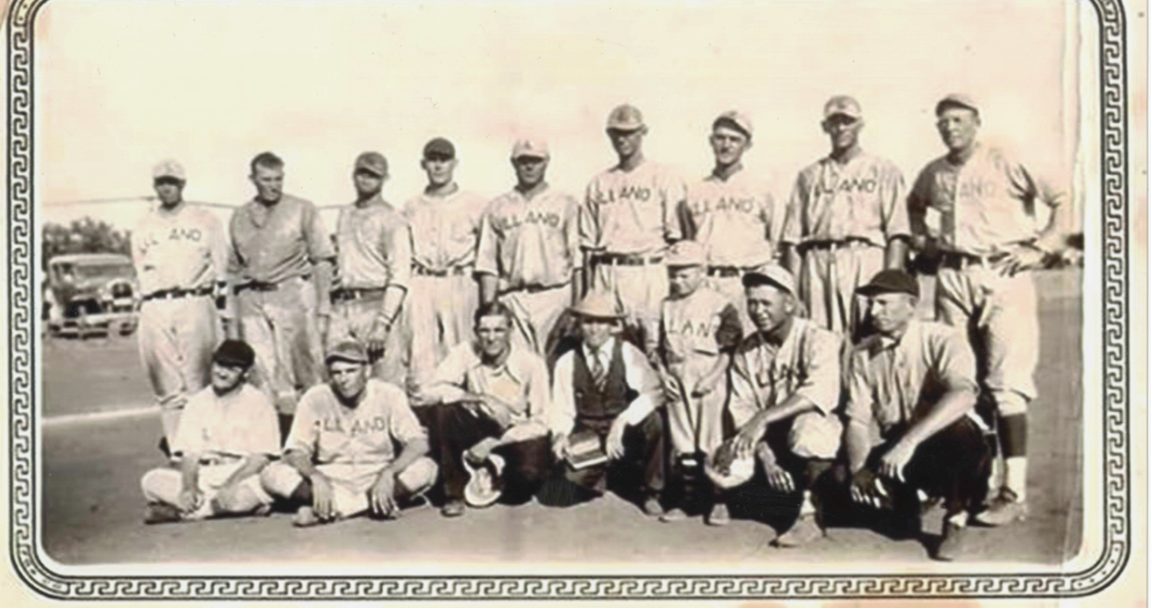
Llano Cowboys, 1930s

Slide 33
Town Ball
Mountain League, 1934
Fredericksburg joined the Mountain League, replacing Alamo Heights
Adding the Giants was a major boon to the Mountain League, renewing rivalries with Boerne, Comfort, and Kerrville

Slide 34
Town Ball
1934 Mountain League Standings:
W L GB Pct.
Fredericksburg 15 1 —- .938
Boerne 12 3 2½ .800
Comfort 6 8 8 .429
Bandera 2 12 12 .143
Kerrville 2 13 12½ .133
Fredericksburg defeated Boerne in the championship series

Slide 35
Town Ball
Hill Country League, 1934
HCL now an exclusively northern league
Teams: Llano, San Saba, Richland Springs, Bend, Pontotoc, Brady, Goldthwaite, Menard
San Saba defeated Richland Springs for the 1934 championship

Slide 36
Town Ball
Mountain League, 1935
League added Legion Cubs as sixth team (played at VA grounds in Kerrville)
New playoff system: Winner of second and third-place teams plays first place team in championship series
In July, Boerne was in first place but withdrew from the league after a controversial league decision to uphold a protest by Legion in the Cubs’ 8-5 loss to Boerne
Boerne returned to “independent” ball, playing industrial teams and HCL teams

Slide 37
Town Ball
1935 Mountain League Standings
W L GB Pct.
Fredericksburg 15 2 —- 882
Legion 10 7 5 .588
Comfort 9 8 6 .529
Kerrville 4 14 11½ .222
Bandera 2 16 13½ .111
Comfort defeated Legion in the 2nd/3rd place playoff game
Fredericksburg defeated Comfort in the championship series

Slide 38
Town Ball
Hill Country League, 1935
Brownwood defeated Richland Springs for the 1935 championship
Llano dropped to combined 2-17 after winning three consecutive titles, 1931-33

Slide 39
Town Ball
1933-35: The Apex of Hill Country Town Baseball
Two high quality leagues (a few future major leaguers and a number who signed pro contracts)
Strong rivalries, exciting pennant races/championship series
Passionate fan support/attendance

Slide 40
Town Ball
Upheaval in 1936
Mountain League dissolved in early 1936 when Fredericksburg returned to the HCL and Kerrville and Comfort did not field a team
Fredericksburg won the HCL championship, defeating Richland Springs for its third consecutive title and its fourth title in seven years
Boerne and Legion played independently then later in 1936 joined leagues

Slide 41
Town Ball
Beyond 1936/League Vicissitudes
After 1936, there were various iterations of the Hill Country League over the years, but some towns played independently
Hill Country town baseball remained strong through the 1940s and 1950s but the “core” Mountain League teams never played in the same league again
Town teams lasted into the 1960s but televised sports and the rise of other sports caused their demise

Slide 42
Town Ball
Former Major Leaguers in the Hill Country Who Played in the Hill Country League or Mountain League
C.L. “Chink” Taylor, outfielder/player-manager, Llano 1930-32, played eight games for Chicago Cubs, 1925
Taylor was the top hitter in the HCL in Llano’s championship years
Scott Perry, pitcher, Kerrville 1932, won 20 games for the Philadelphia Athletics in 1918, retired in 1921 at age 30
Perry was rocked in his only start for Kerrville as a 41-year-old

Slide 43
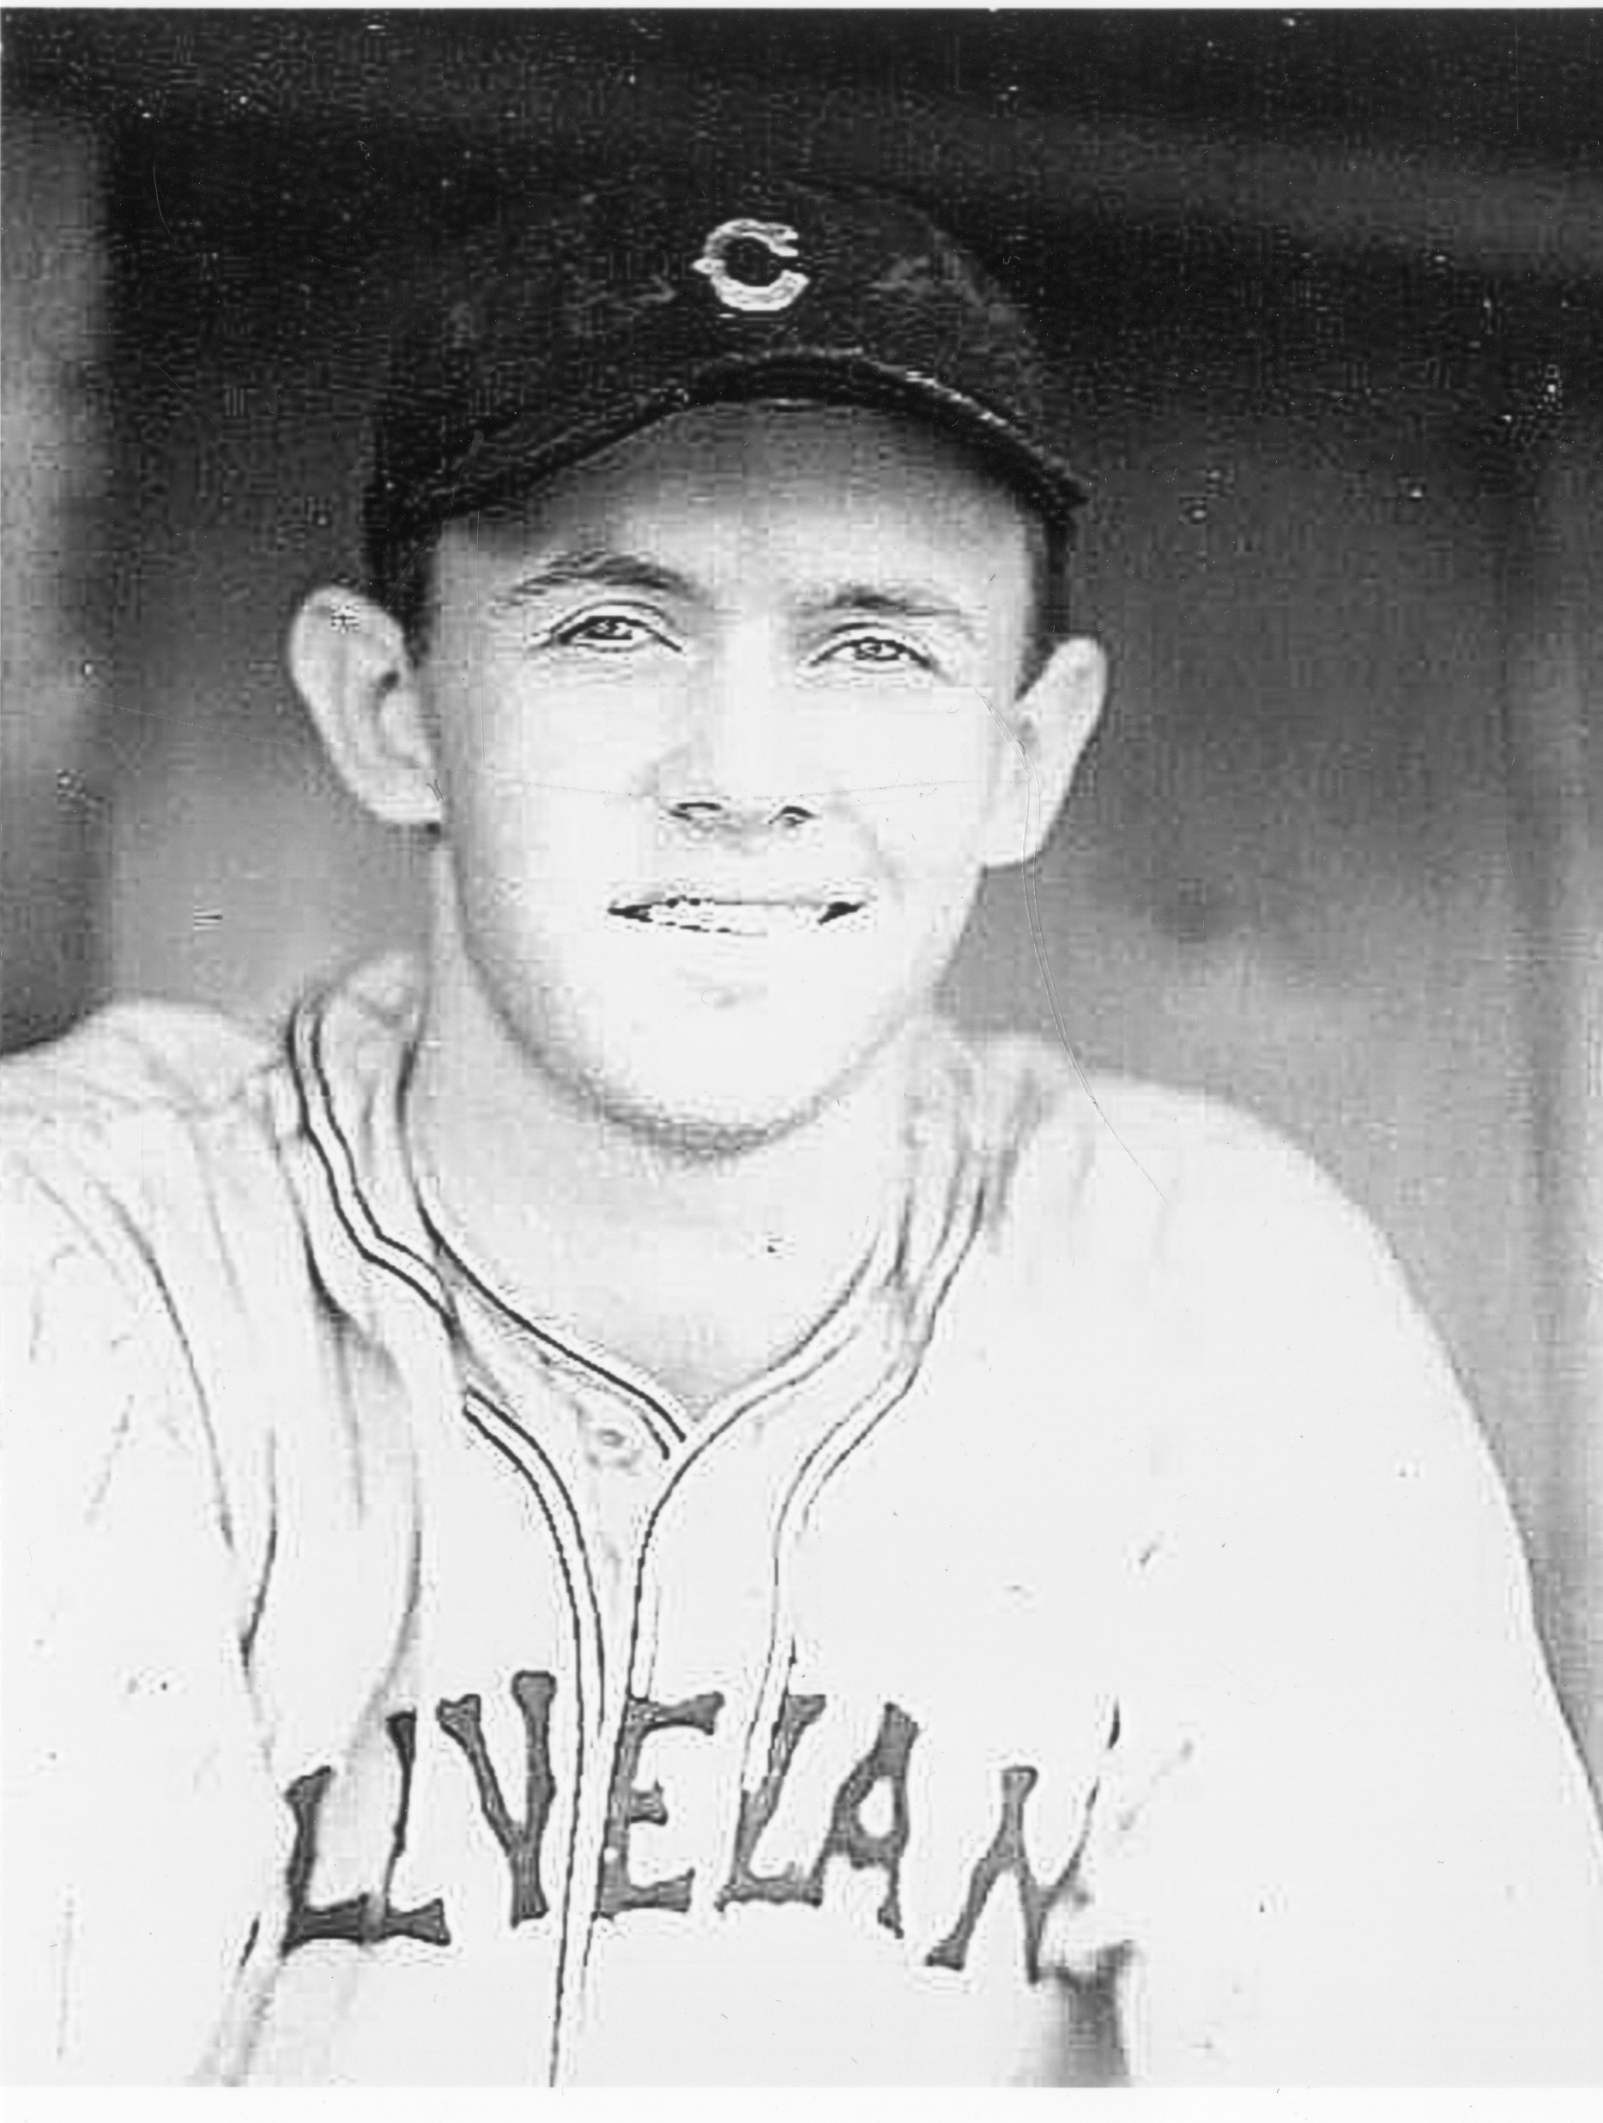
Town Ball
Charlie Suche
Hill Country Players Who Rose to the Major Leagues (albeit briefly) after playing in the Hill Country League or Mountain League:
Charlie Suche, pitcher, Alamo Heights, 1933, pitched one game in relief (1-1/3 inning) for the Cleveland Indians in 1938

Slide 44
Town Ball
Charlie English, shortstop, Boerne, 1930 (and teammate of Dizzy Dean at Fort Sam Houston before that) saw action in parts of four seasons as a reserve infielder with the White Sox, Giants, and Reds, between 1932 and 1937
Hugo Klaerner, pitcher, Fredericksburg, late 1920s-1933, started three games for the Chicago White Sox in September 1934, 0-2 record. Klaerner later served as Gillespie County Sheriff for 30 years (1950-1980)

Slide 45
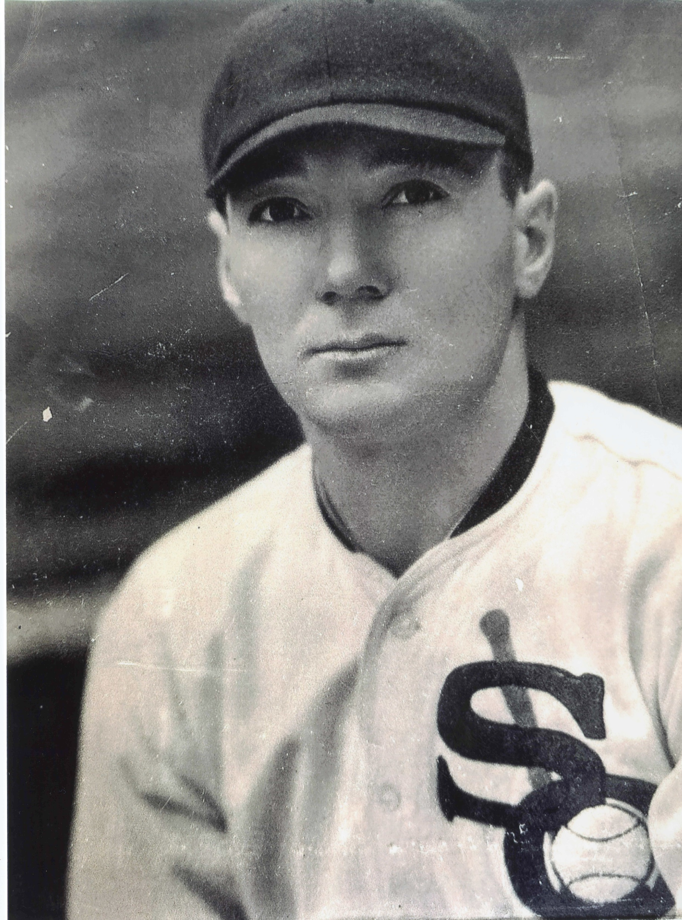
Town Ball
Hugo Klaerner

Slide 46
Town Ball
Kerrville All-Stars, Black town baseball
In Jim Crow era, Kerrville All-Stars flourished as a Black town team
Plentiful Black baseball talent in Texas such as Hall of Famers Rube Foster, Willie Wells, Smokey Joe Williams, and Biz Mackey
Texas Colored League (TCL), semi-pro league, 1920-23 (Austin Black Senators, San Antonio Black Aces)
Texas-Oklahoma-Louisiana League (TOL), pro league, 1929-31 (San Antonio Black Indians)
Houston Black Buffaloes, TOL champion, played KC Monarchs in postseason series, 1929-30

Slide 47
Town Ball
Kerrville All-Stars were the most prominent Black team in the Hill Country
Descendants of slaves who settled in Kerr County after the Civil War, restricted to 20 blocks on north side of Kerrville
Began play not later than 1922
Played mostly Black teams from San Antonio and Austin
Often played the second game of a doubleheader against another Black team after Kerrville’s White team played the opening game

Slide 48
Town Ball
Little newspaper coverage of Black teams (unlike White teams)
Only a single box score found through 1930s
Occasionally played White teams: Kerrville Braves in 1932, and Legion Cubs in 1933
Popular with White fans who attended All-Stars games (in segregated sections)

Slide 49
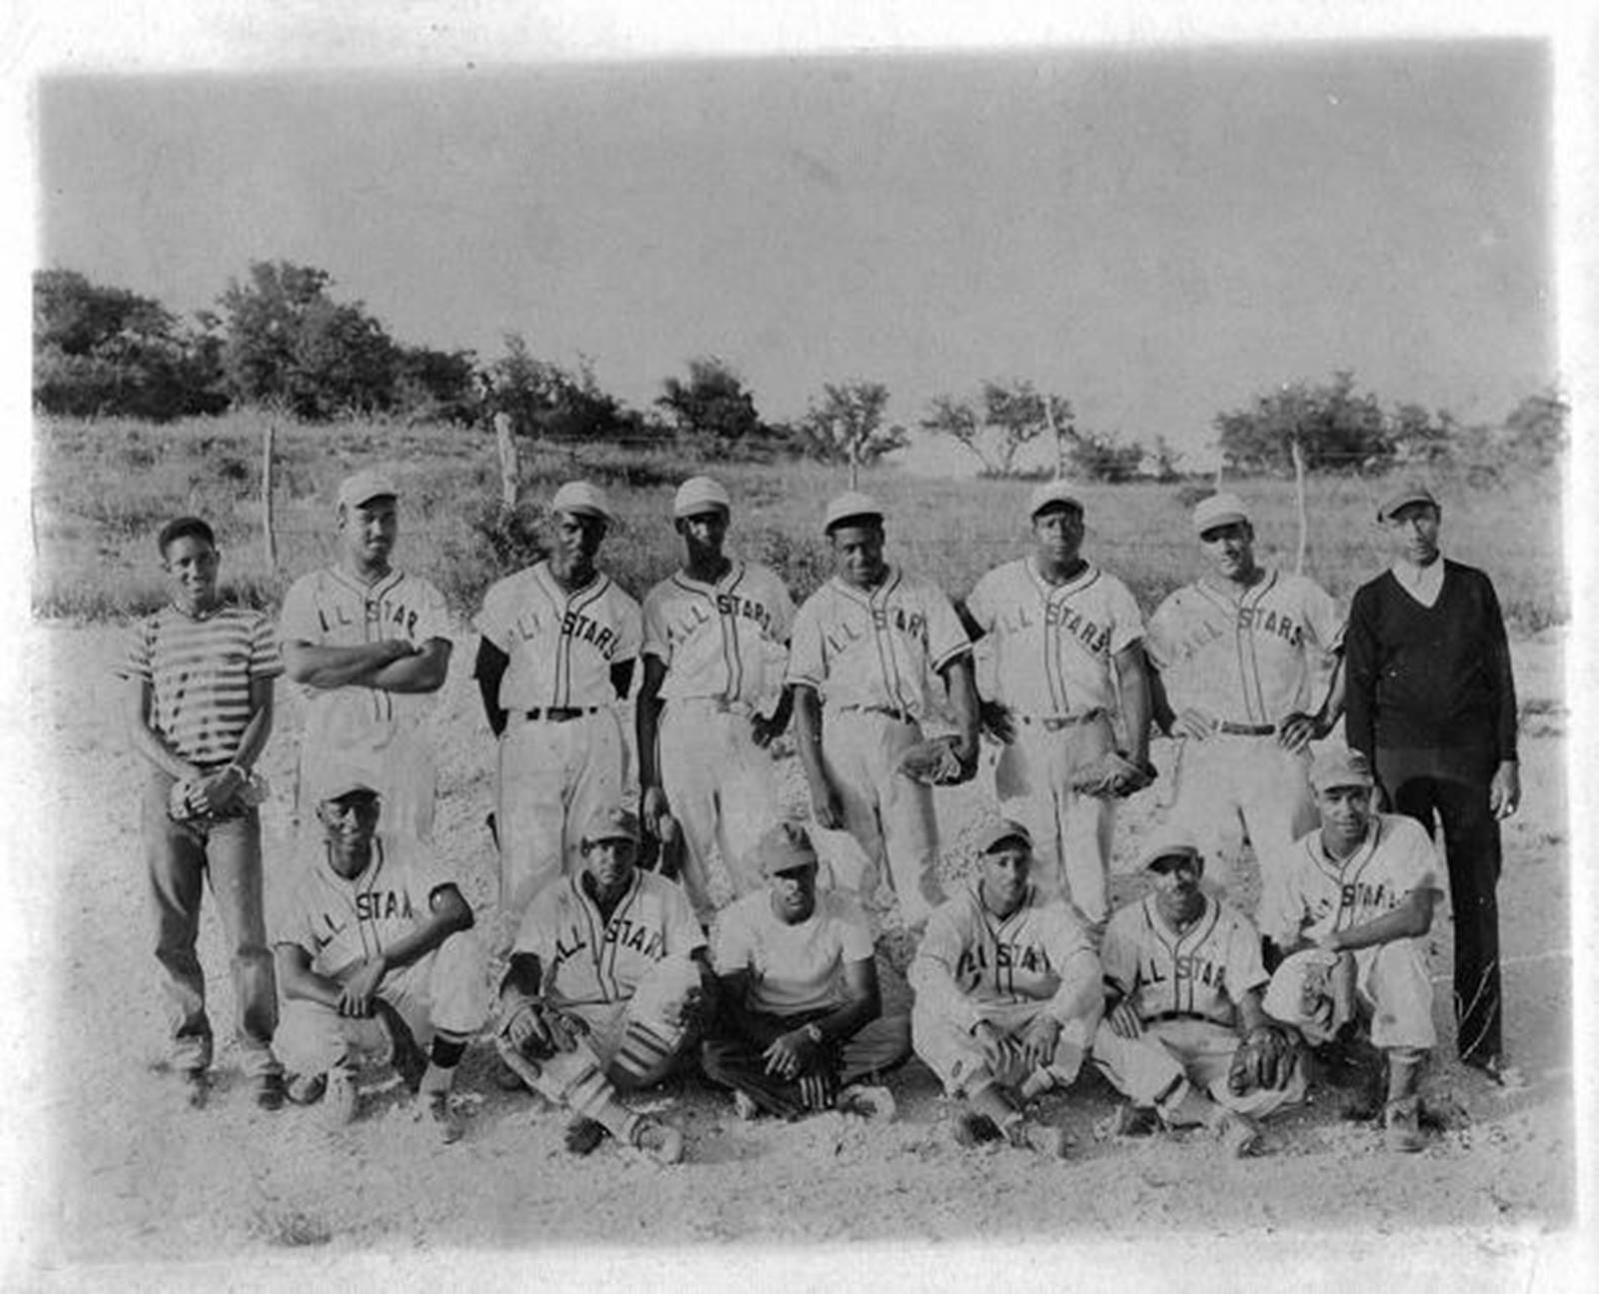
Town Ball
All-Stars, 1949

Slide 50
Town Ball
Cultural Significance:
In Kerrville’s Black community, there were three important institutions:
1) Black churches (two)
2) Doyle School (originally known as Colored School)
3) Baseball/All-Stars
An All-Stars doubleheader was the main feature of Juneteenth celebrations
It was considered an honor for a high school graduate to join the All-Stars

Slide 51
Town Ball
Later History & Significance
The All-Stars joined a later iteration of the Hill Country League in 1960, integrating the formerly White league with an all-Black team
All-Stars played through 1970 before suffering the same demise as White teams in the era of television
The All-Stars were even more important to the Black community than White teams were to the German-dominated towns
Baseball was one of the few public outlets, perhaps the only one, for Blacks to express pride and unity during Jim Crow

Slide 52
Town Ball
Wrap Up
Baseball was woven into the social fabric of the Hill Country, local sports heroes
The quality of baseball was high in the Hill Country, especially in the 1930s
The 1930s were the pinnacle of Hill Country town baseball
Baseball unified town residents, shielding them against the worst effects of the Depression and providing a much-needed respite
The ethnic bonds of German settlers and the racial bonds of Kerrville’s Black community were strengthened by baseball in difficult economic times

Slide 53
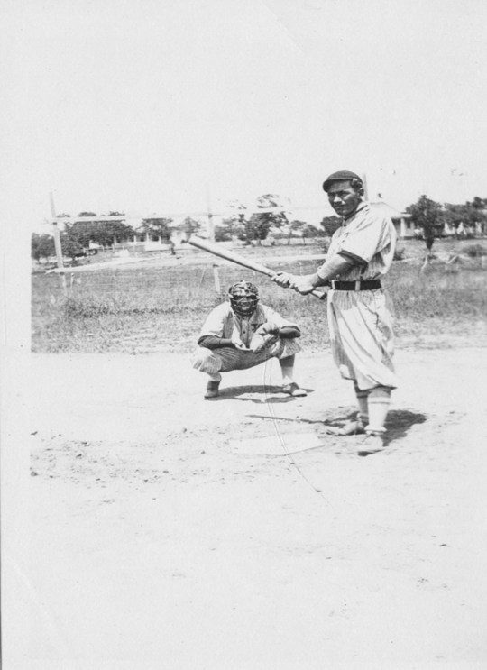
Town Ball
Questions?

