Slide 1
Road to Cooperstown: My photo of Ichiro’s 3,000th professional hit
Gilbert D. Martinez
Chapter Commissioner
SABR Rogers Hornsby Chapter
20th Annual Bill Gilbert Winter Meeting
Jan. 10, 2026

Slide 2
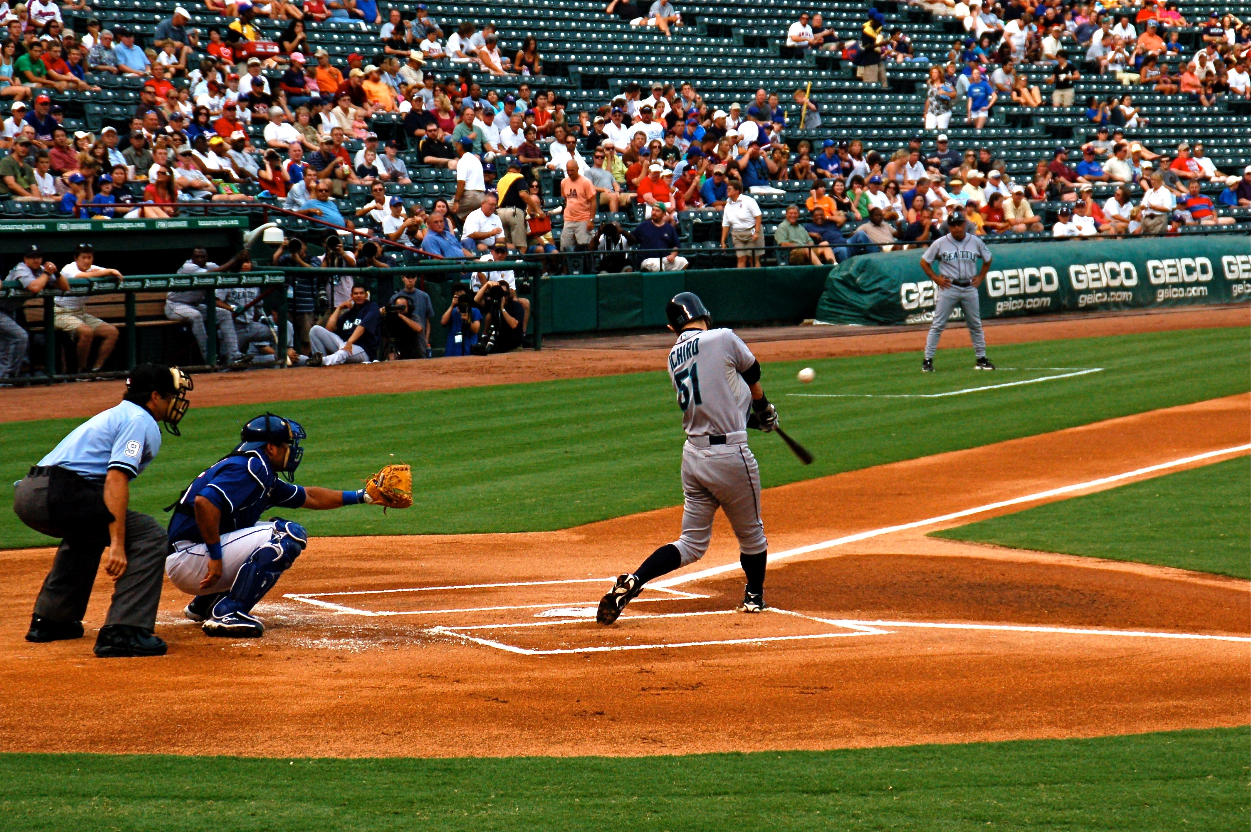
On the first pitch of the Mariners-Rangers game on July 29, 2008, I took this photo of Ichiro Suzuki’s leadoff at-bat. The bloop single fell behind Rangers shortstop Michael Young, signifying Ichiro’s 3,000th professional hit (1,278 hits in NPB + 1,722 hits in MLB).

Slide 3
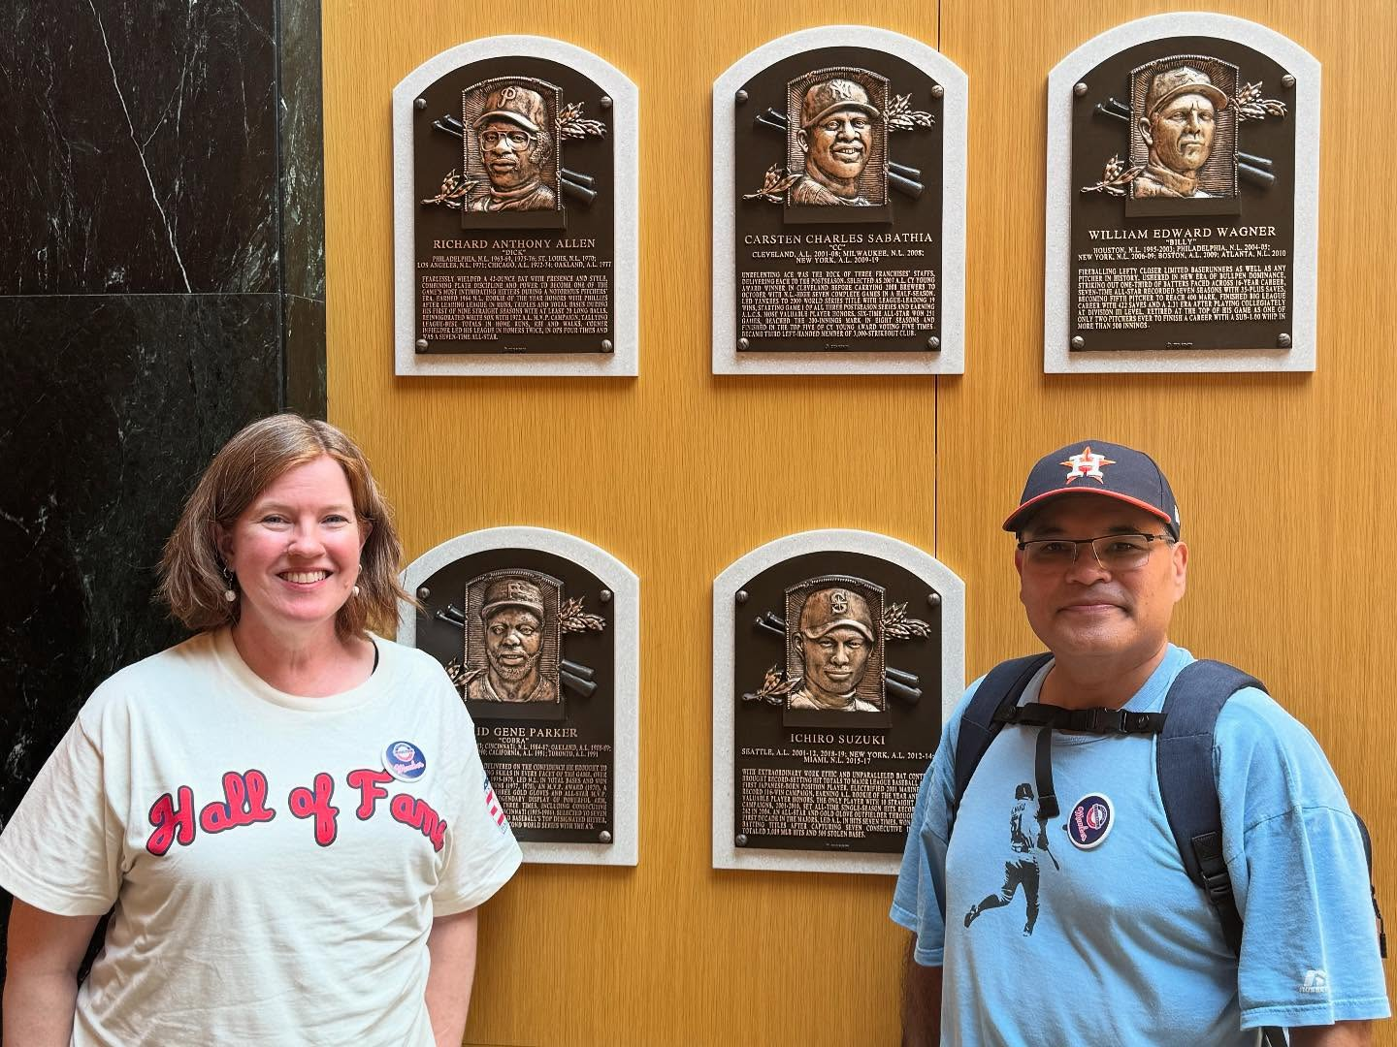

Slide 4
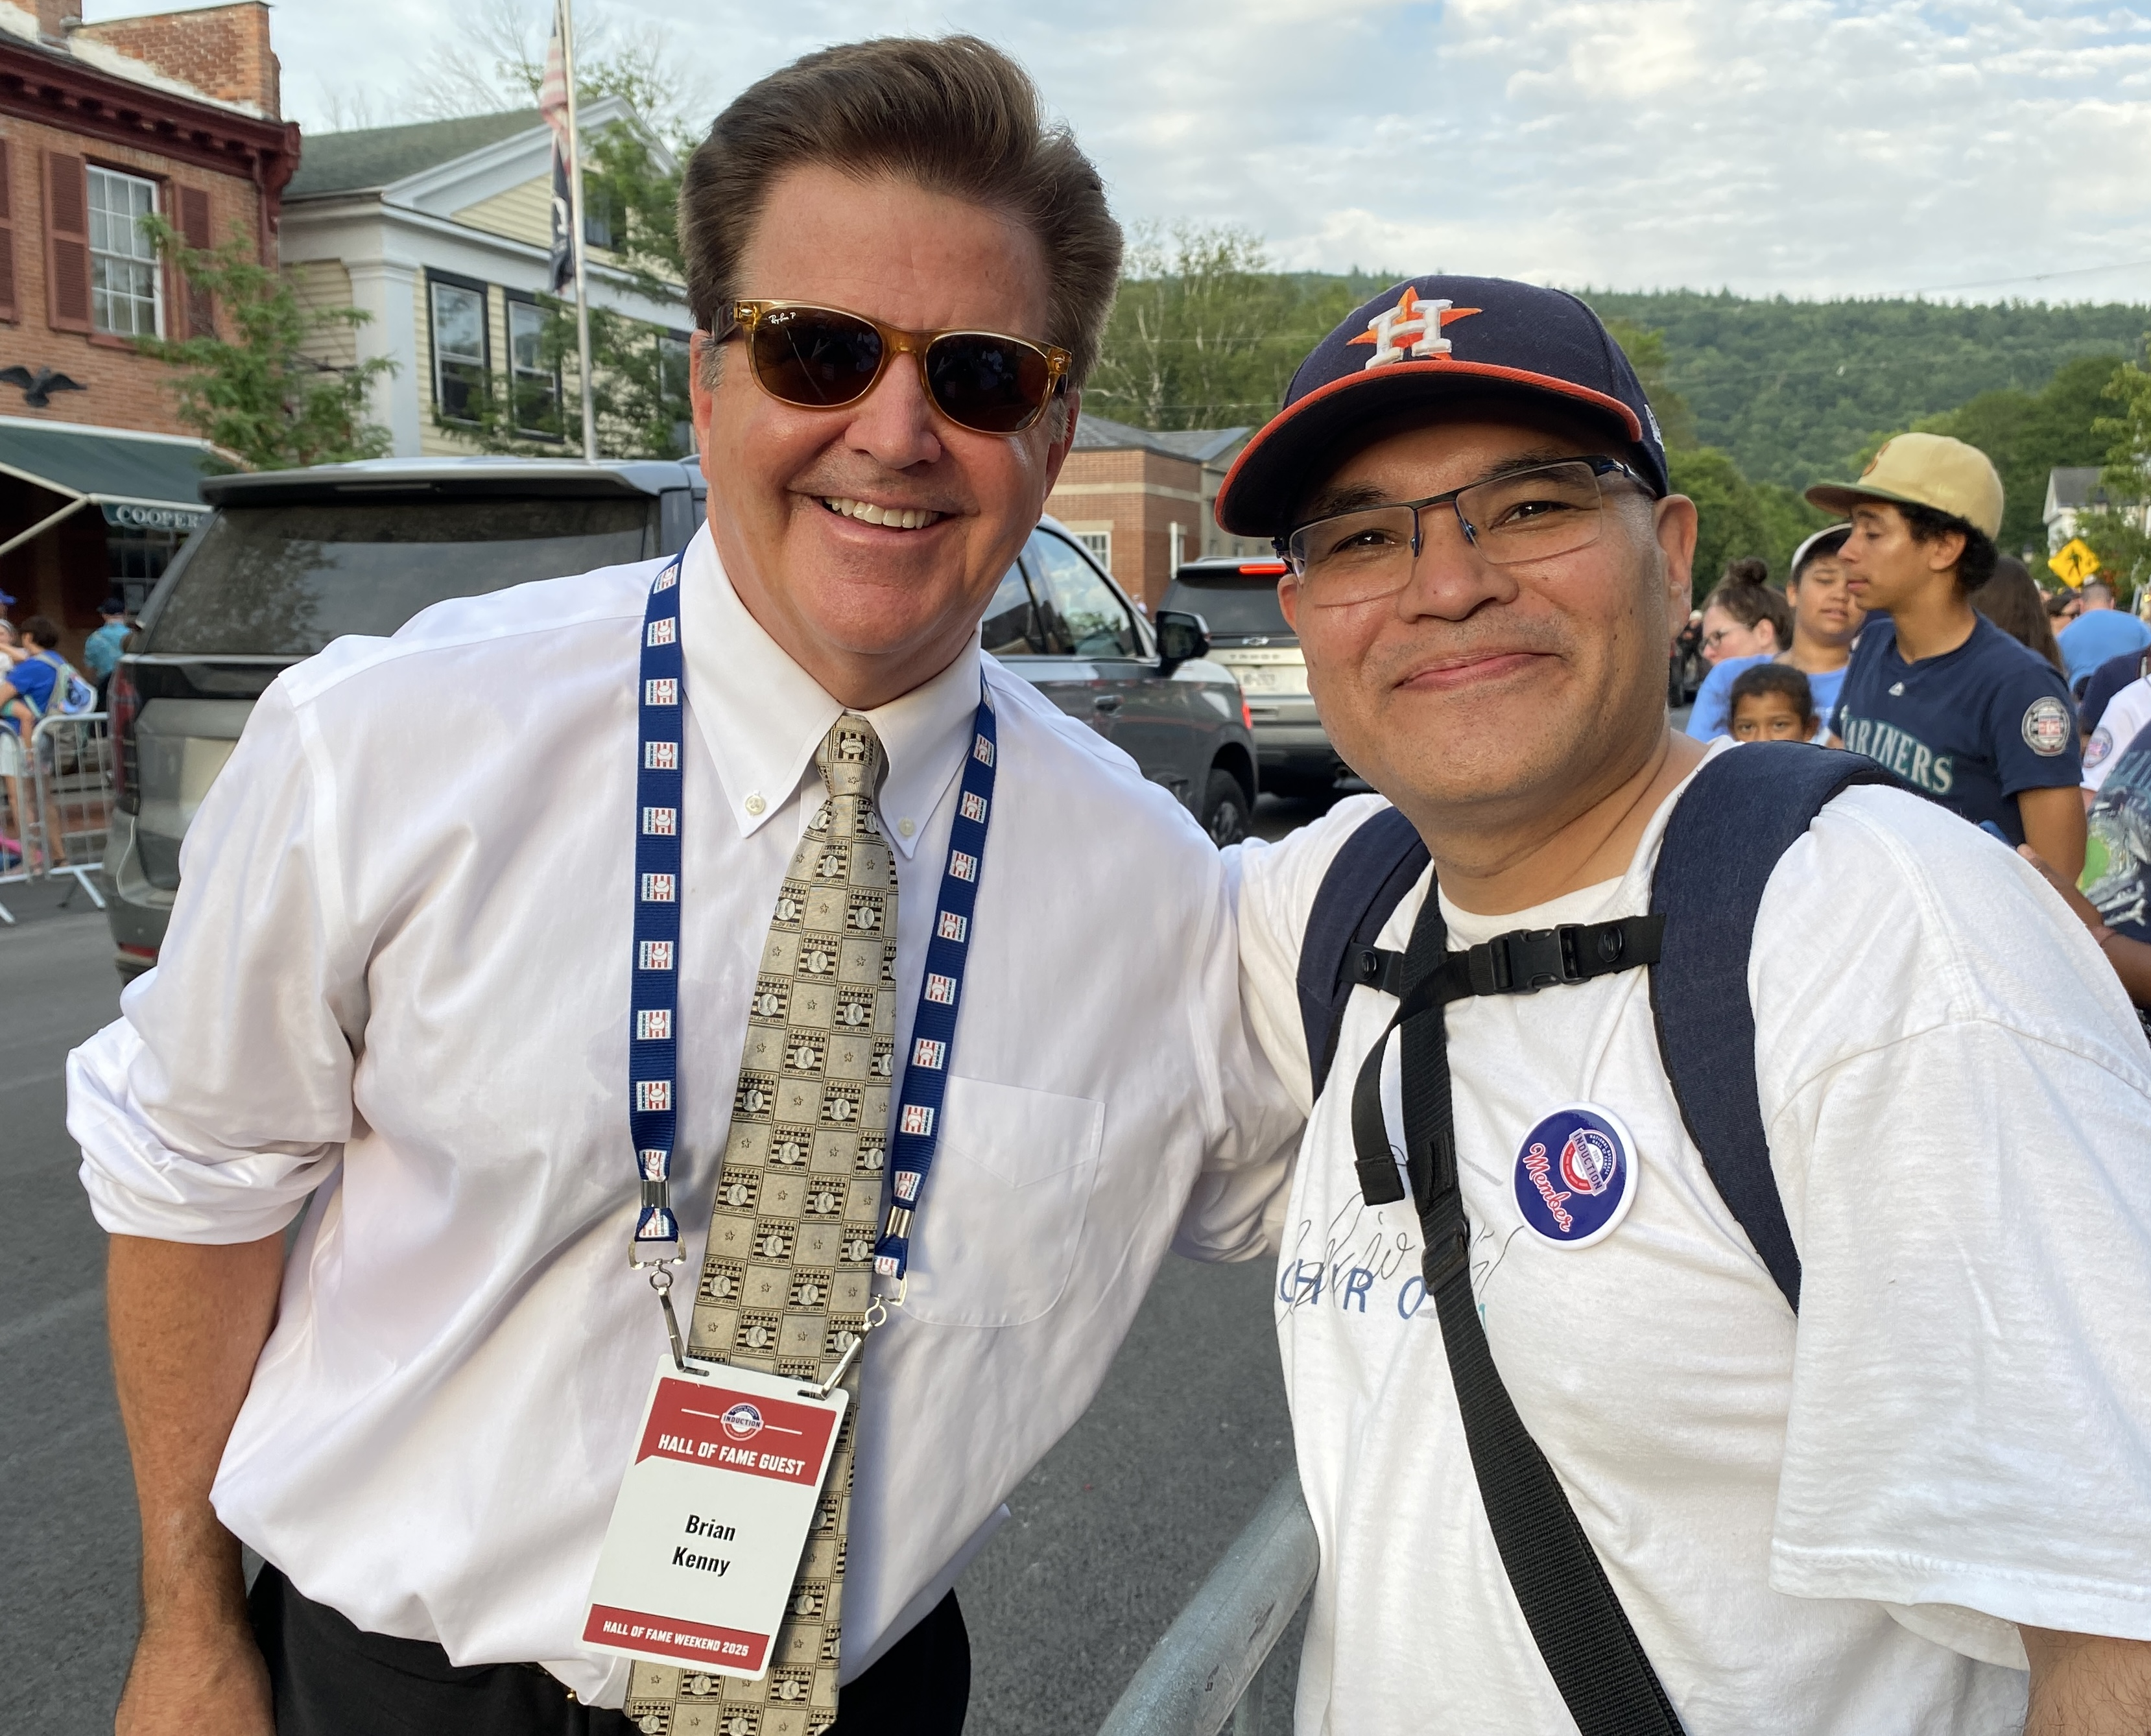

Slide 5
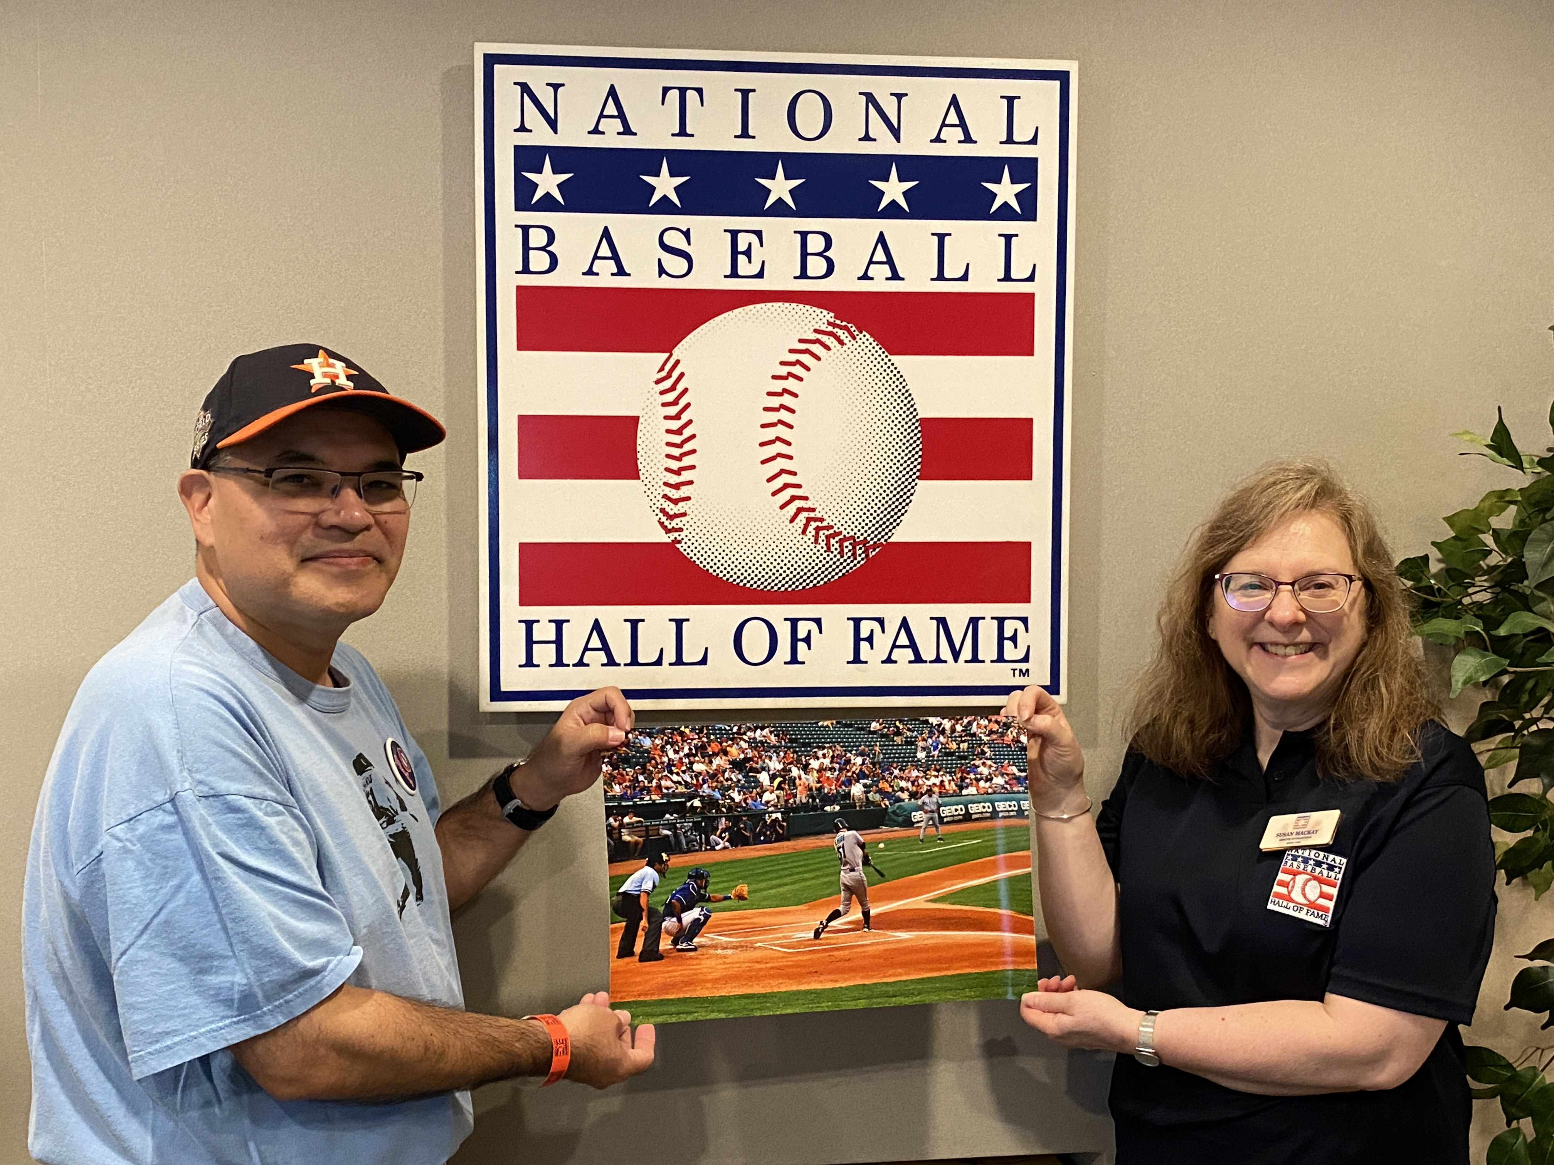
I donated my photo of Ichiro’s 3,000th professional hit to Sue MacKay, director of collections relations at the National Baseball Hall of Fame and Museum in Cooperstown in July 2025. The photo is being added to its Digital Assets Management System.

