Slide 1

“The Emerald City”
20th Annual
Bill Gilbert Winter Meeting
10 January 2026
Frank Rechtorovic
Notes:
I’ve been to all 20 Winter Meetings. I’m proud of that. I live an hour north of Austin. The drive here isn’t bad. I don’t look forward to the drive home.

Slide 2
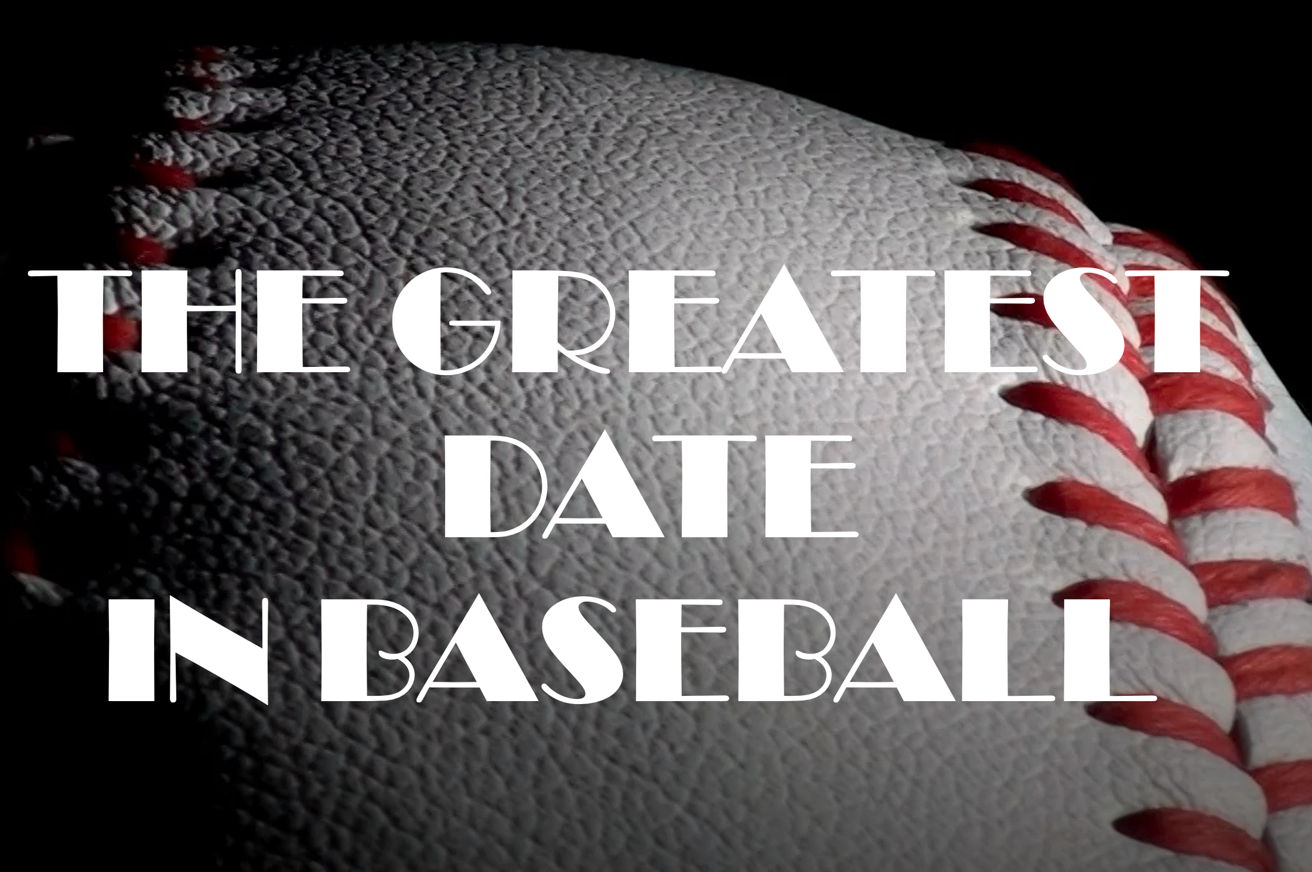
9-7-61
Notes:
In my presentation last year, I shared how I believe that my birthday, 9-7-1961, is the greatest DATE, not day, in baseball. Oh, and I turn 65 this year. I also shared how on that date, Roger Maris hit his 55th home run.

Slide 3

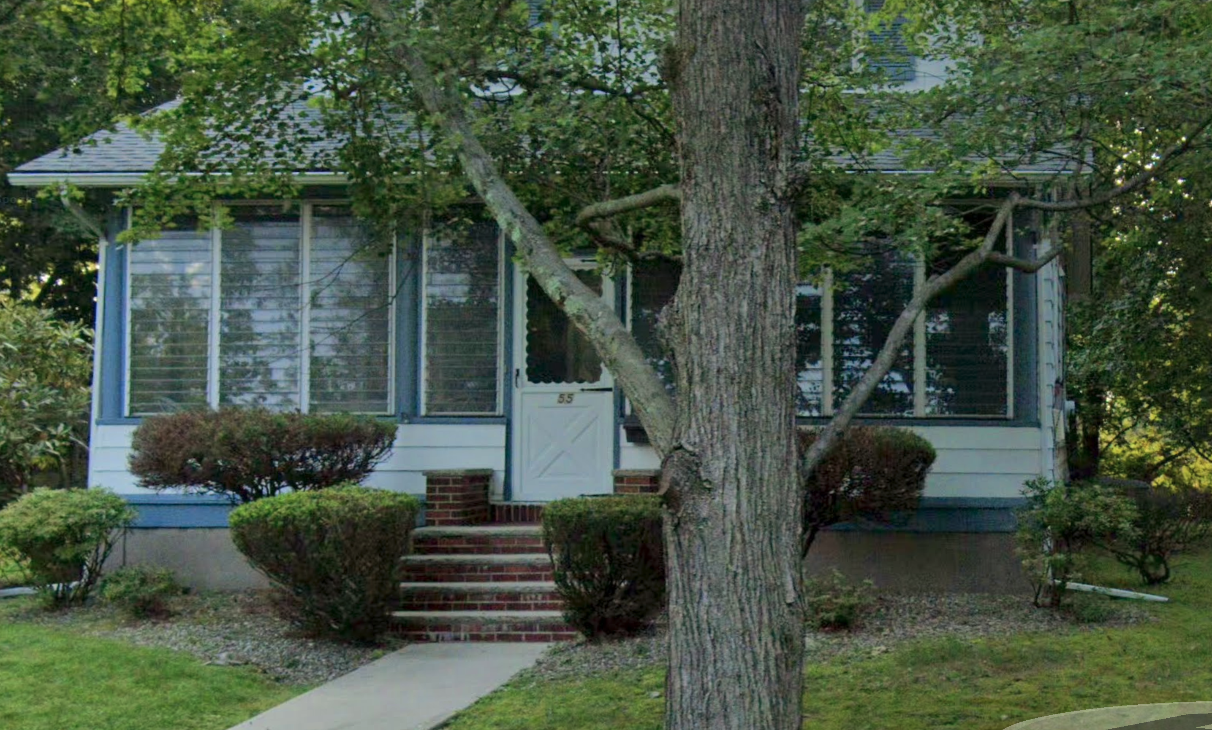
Notes:
And the house that I grew up in was 55 Summit Ave in New York, 20 miles from Yankee Stadium. That number 55 rolls right into this year’s presentation.
But before I get there, I must explain how my story about the “The Emerald City” started.

Slide 4
Fort Drum, NY
July 1991-March 1996
Notes:
I had been stationed at Fort Drum, New York since July of 1991, and I would be there until March of 1996. I was a court reporter/paralegal, and one of the attorneys I worked with, Roger Cartwright, was from Tacoma, WA. During his time at Fort Drum, he transitioned from the Regular Army to the Army Reserves in WA.

Slide 5
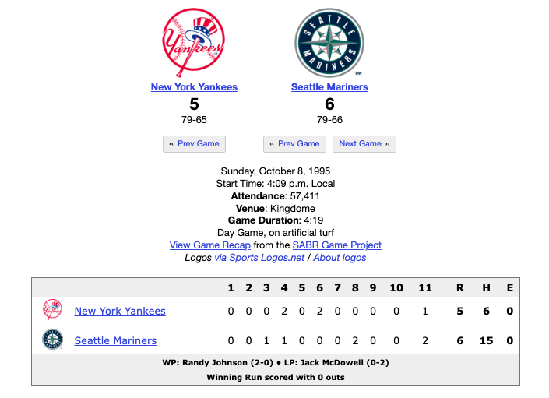
Edgar's Double to Win The Series
Notes:
On 8 October 1995, American League Division Series, Game 5, Yankees vs Mariners, Seattle Kingdome, I recorded the game on VHS. After Edgar Martinez hit the double that scored Griffey to win the game, and the series, I boxed up the tape and sent it to Cartwright. I knew I didn’t want to go through that pain again.

Slide 6
Camp Zama, Japan
April 1996-March 1999
Notes:
After Drum, I was sent to Japan from ’96-’99.

Slide 7
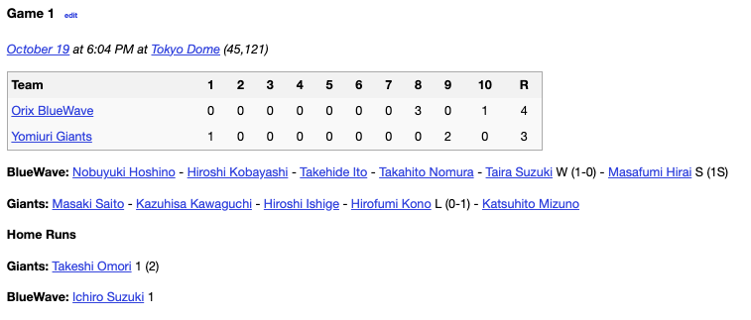
Ichiro's Home Run in the 10th
Notes:
I watched this game on TV and the next day I went to the newsstand and bought the paper for a souvenir.

Slide 8
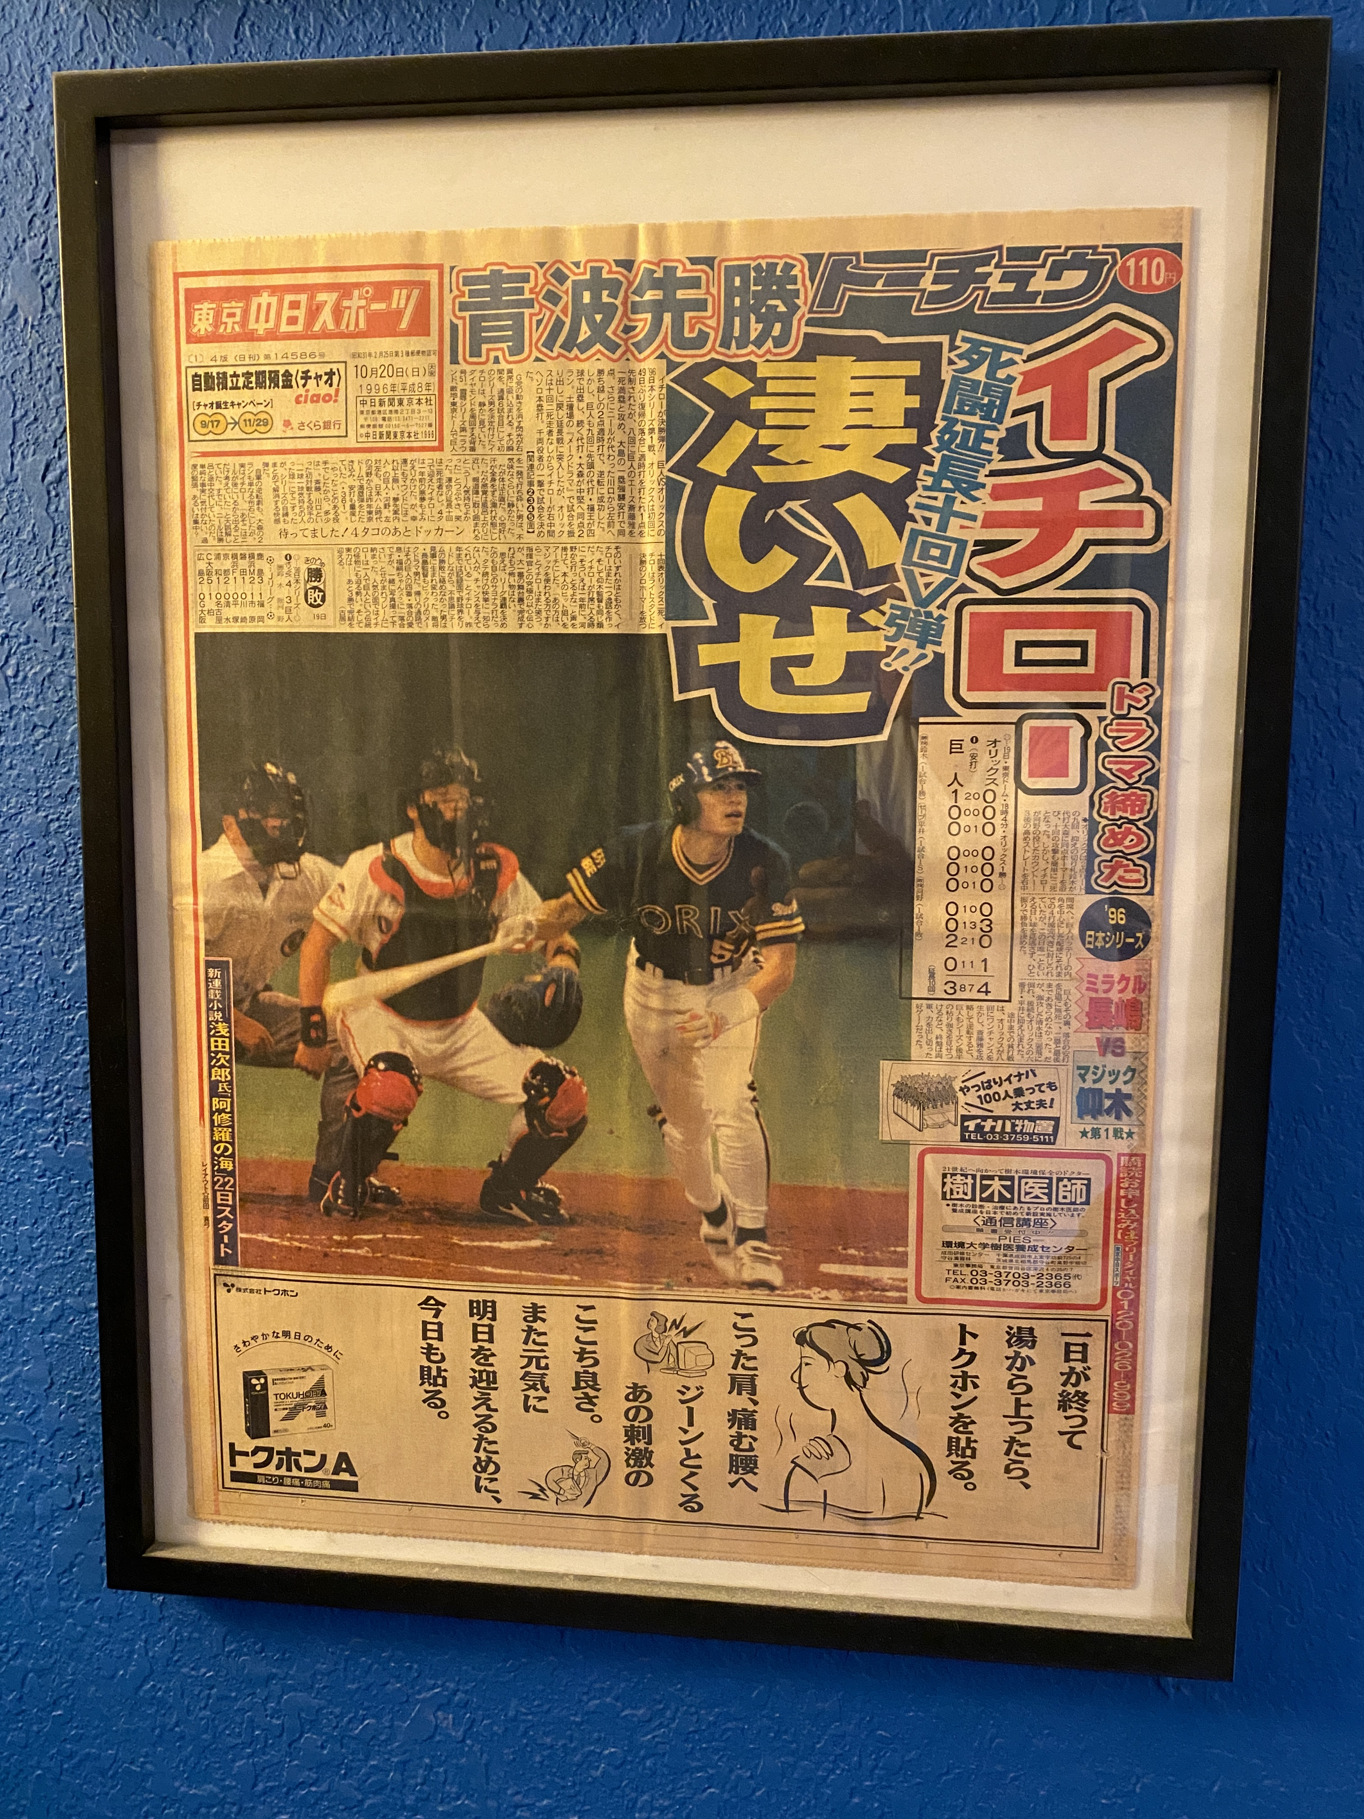
Notes:
Sometime after I joined this chapter, I learned that Gilbert was an Ichiro fan. I framed the newspaper and gave it to him. I then learned that the date on the newspaper is his birthday.

Slide 9
Fort Hood, TX
Notes:
At the end of my tour in Japan, I had orders to Fort Hood, TX. I was excited to work with a former boss, and that it was close enough to drive to see my parents in Florida.
Two months before my tour ended, I got a call offering Fort Lewis, WA. I knew that it was a popular assignment, and I should be happy about it, but I wanted to go to Texas.

Slide 10
Fort Lewis, WA
April 1999-May 2001
Notes:
I ended up in Washington, and it was my best assignment during my 20 years in the Army. Once I had the assignment, I got online and bought tickets to the final game in The Kingdome. Tickets for the first game in Safeco Field were already sold out.
When I got to Fort Lewis in April 1999, I contacted Cartwright and learned that he got a job on the Mariners grounds crew when Safeco Field would open in July of 1999.
I was at Fort Lewis until May of 2001. I was transferred to Fort Leonard Wood, Missouri, because the new job would eventually help me get promoted. So, I was not in WA for the All-Star game that year.

Slide 11
55
Seattle Mariners games
Notes:
I ended up seeing 5 games in the Kingdome, and 50 games in Safeco. 55 total games.
After Mass on Sunday morning, 2 May 1999, I surprised our five kids (3 boys and 2 girls, ages 10 -2) and we headed to our first game. Seattle scored two runs in the bottom of the 9th to beat Toronto, 3-2. It was exciting. I paid $15 to park close to the Kingdome, only to find out we had to walk a good way around the fencing of Safeco Field construction that was still going on. I would later learn from Cartwright where I could park for free and have an easy out for the 55 minute drive home.
The kids got free Mariners T-shirts that day. Rodriguez, #3. We had no idea who he was, and he was out with an injury from 7 April until 14 May. We often laughed about that through the years.

Slide 12
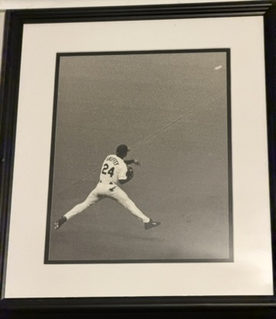
Notes:
On 12 June, I took this photo of Griffey running to his right from Center Field, reaching out his glove to make the catch, and then spinning around to make the throw. I don’t remember the play specifics, though. The Giants won the game, 15-11. Bonds went 1-7 and left 7 runners in scoring position. Jeff Kent hit a homer.

Slide 13
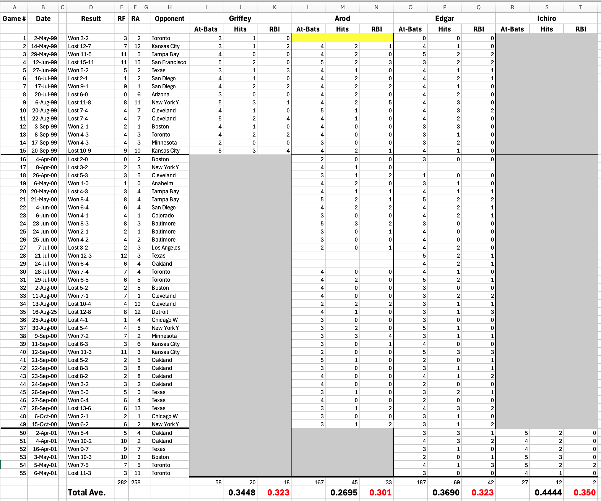
Notes:
I could go on and on about the 50 games I saw in Safeco, often buying a $5 bleacher ticket that eventually went up to $7. I loved how I could walk the entire concourse and still see the game. I would never try and move down to better seats.
From my first game on 2 May 99 through my last game on 6 May 2001, I enjoyed watching Griffey, A-Rod, Edgar, and Ichiro. I was curious to know how these players fared while I was at the games, against how they did for the year. I put together this spreadsheet.

Slide 14
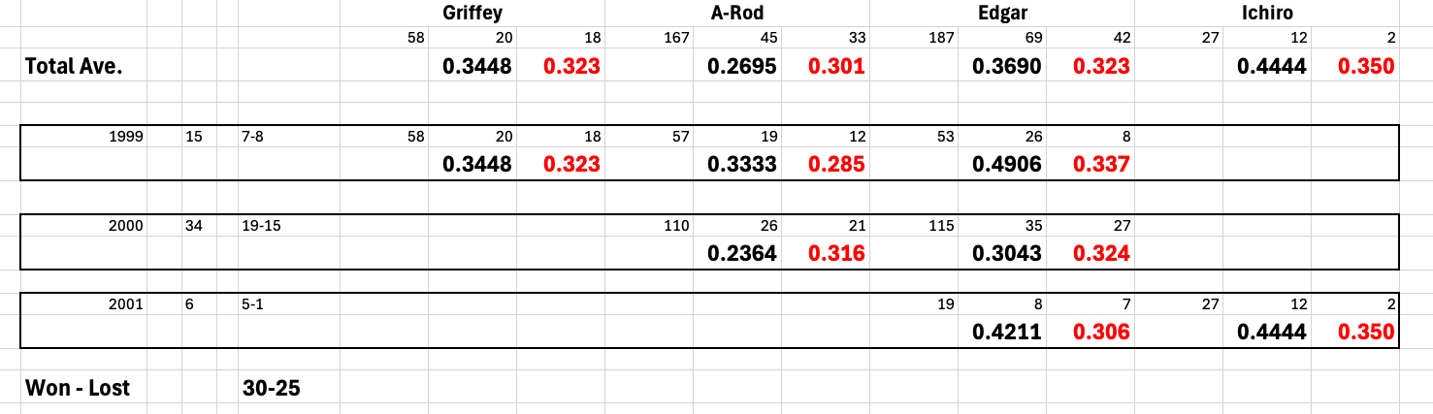
Notes:
Griffey: Only there in 1999; A-Rod, 99-00; Edgar all three years; and Ichiro just the last year.
Except for A-Rod, everyone performed better while I was there. Not that it had anything to do with me.

Slide 15
Hall of Fame Inductions
1992 – Tom Seaver
1993 – Reggie Jackson
1994 – Phil Rizzuto
2019 – Edgar Martinez
Notes:
Ichiro was the inspiration behind this presentation, as he was elected to the Hall of Fame last year. While at Fort Drum, I took the two-hour drive to Cooperstown at least a dozen times. I saw the 1992 induction ceremony of Tom Seaver, the 1993 induction ceremony of Reggie Jackson, and the 1994 induction ceremony of Phil Rizzuto. All three New Yorkers. I couldn’t go to the 1995 ceremony, though I was still stationed in New York, as the Army sent me to a two-month school in South Carolina. In 2019, my wife and I, with our three oldest boys, drove up to see Edgar Martinez get inducted. Edgar was my favorite Mariner.

Slide 16
Ichiro Commercial

