Slide 1
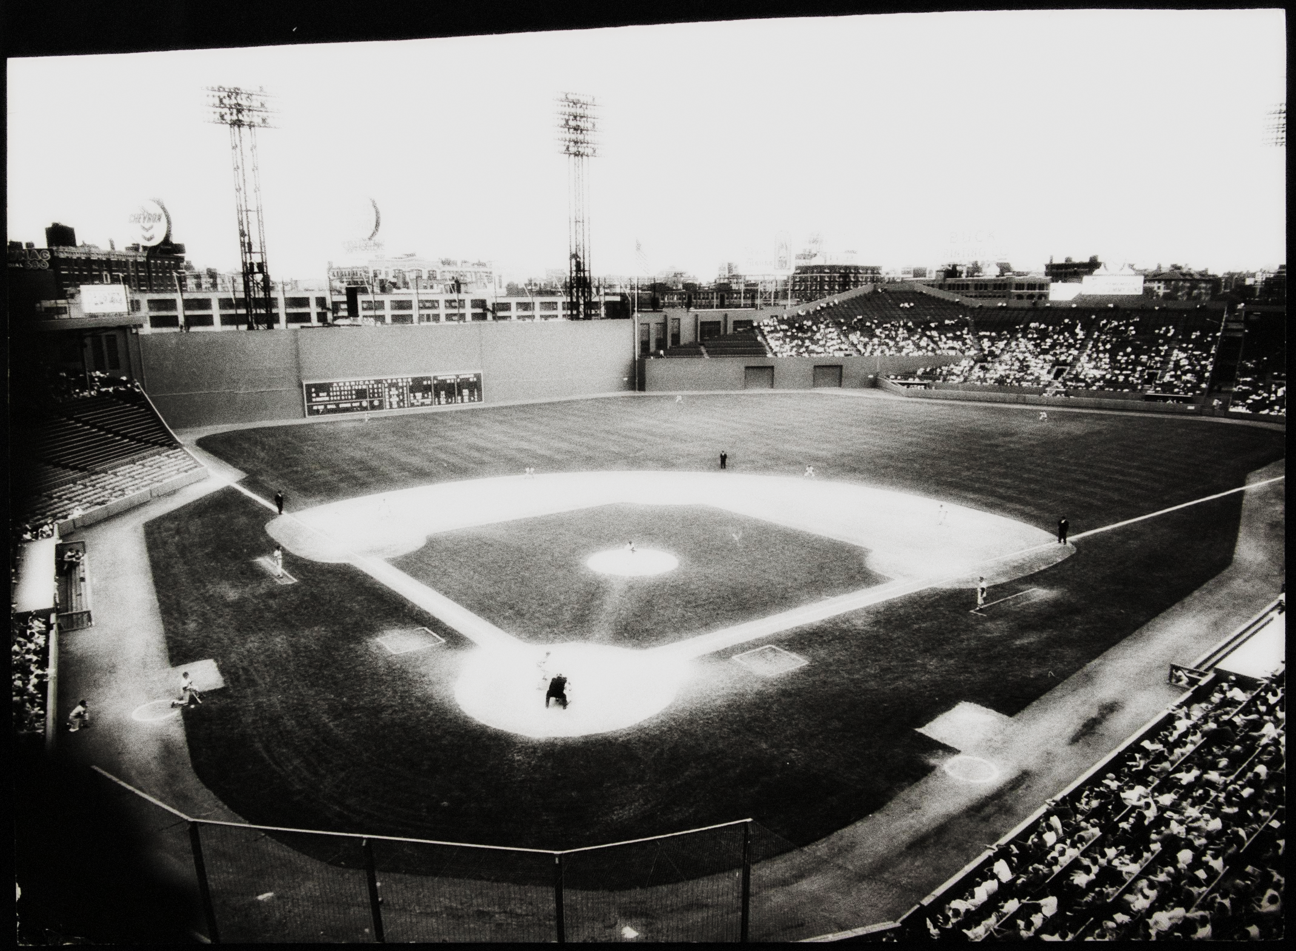
Baseball Board Gaming
Dick Butler
Larry Rice

Slide 2


BASEBALL BOARD GAMING
WHAT IS “BASEBALL BOARD GAMING”?
BRIEF HISTORY OF BASEBALL BOARD GAMES
WHY PLAY BASEBALL BOARD GAMES?
BRIEF ONE INNING DEMONSTRATION

Slide 3
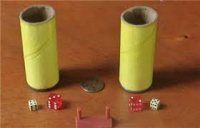
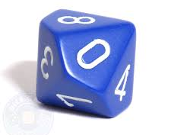
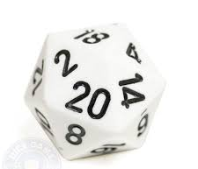
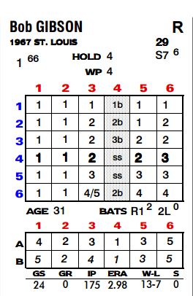
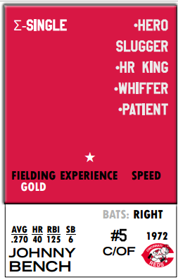
WHAT IS BASEBALL BOARD GAMING?
Board game that typically uses individual player cards to represent actual player performance with outcomes determined by the rolling of dice
Outcome results, based on these dice rolls, can either come off the player cards or through chart lookups
Computer versions of many of these games exist, although many prefer physical cards and dice
Can be played solitaire or with/against opponent
Game “engines” vary widely but provide reasonably accurate results based on actual statistics
NOTE: SABR has an active Games & Simulations Research Committee

Slide 4
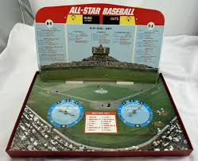
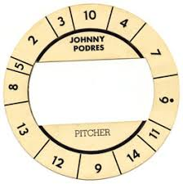
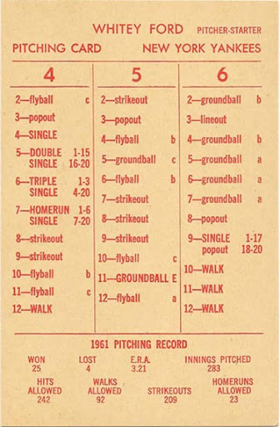
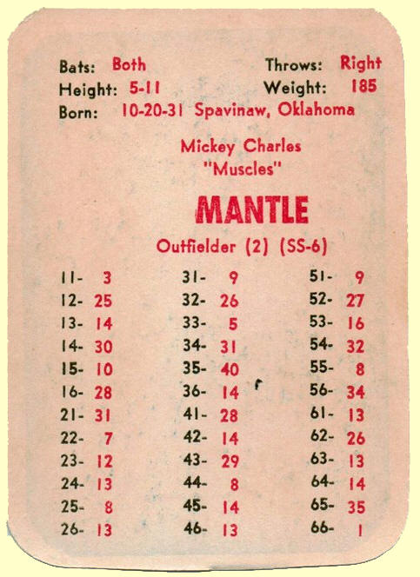
HISTORY OF BASEBALL BOARD GAMING
Simple parlor games attempting play baseball have existed since early 1900s
The 1940s through the early 1960s saw the first major mass production (Cadaco All-Star Baseball, APBA, Strat-O-Matic)
The 1970s and 80s saw an increasing number of released games, but many only lasted a handful of seasons
In the last 20 years, with the proliferation of statistics, multi-sided dice, computers & the internet, the industry has seen a renaissance in the number, approaches & accuracy of baseball simulation games

Slide 5
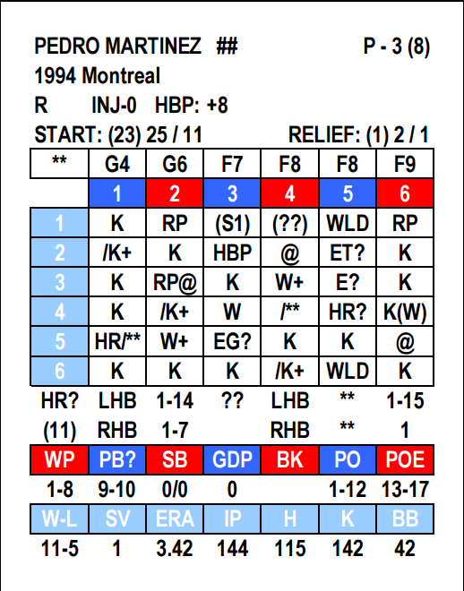
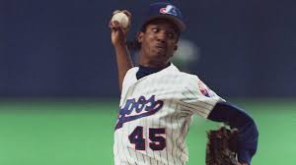
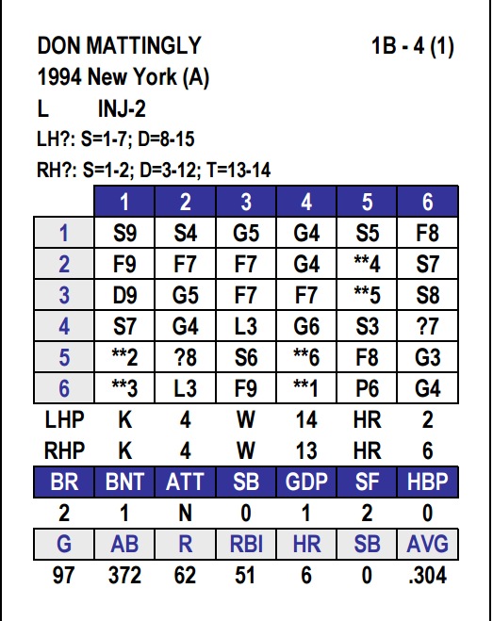
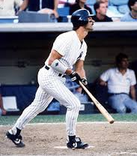
WHY PLAY BASEBALL BOARD GAMES?
Which one of us haven’t thought we could do a better job of managing? You decide lineups, strategy, pinch hitters, relievers, etc
Nostalgia…the ability to re-live 1968…1976…1982. Play games with the players of yesteryear. Replay World Series matchups, hold tournaments or even replay an entire season
“What if?” – 1994 had a World Series? The teams with the 2 best records in baseball made the playoffs in 1981? The 1927 Yankees played the 1968 Tigers? Negro Leagues vs …
Test the principles of Sabermetrics etc, etc, etc

Slide 6
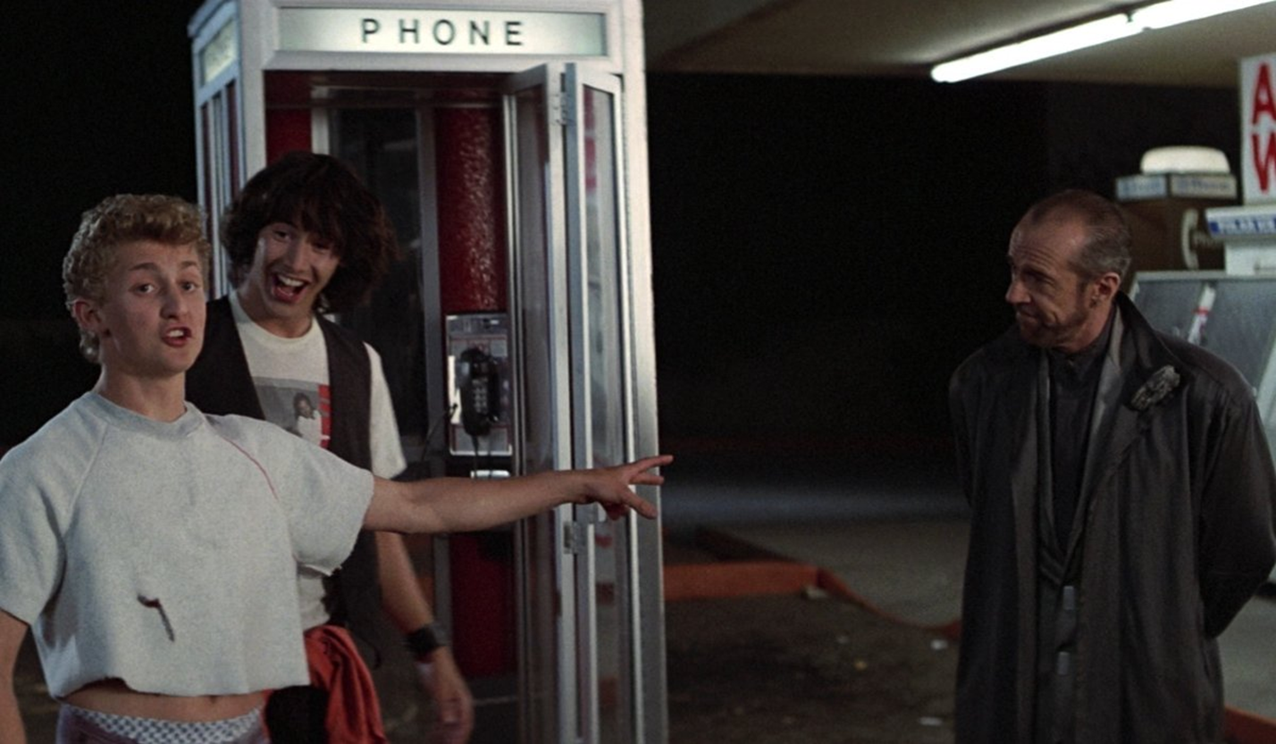
LETS SEE HOW IT MIGHT WORK…
OCT 2 1978
AL East Tiebreaker
Top 7th Inning
Yankees 0
Red Sox 2

Slide 7
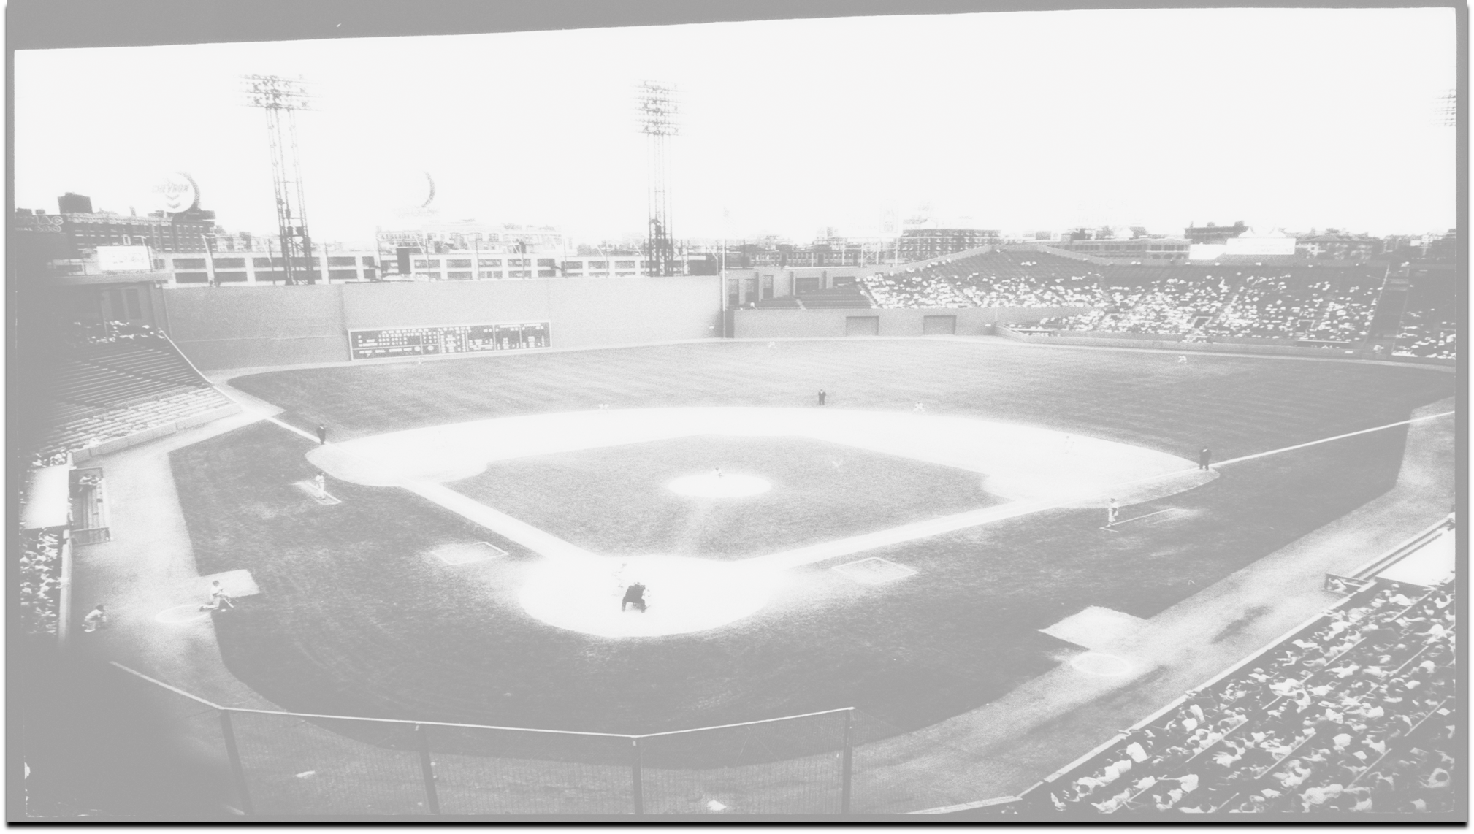
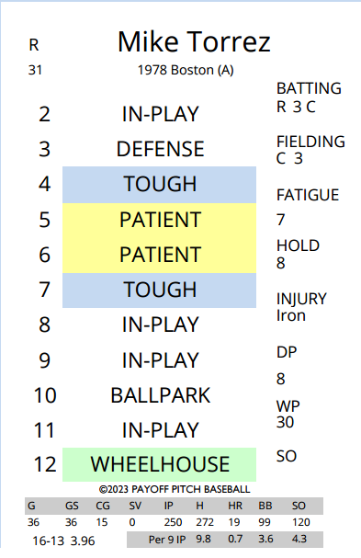
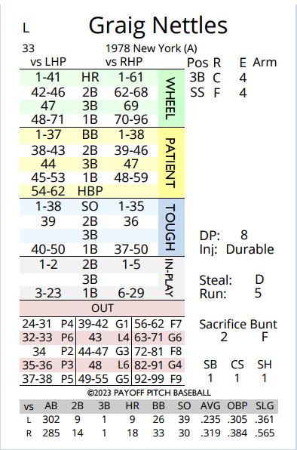

Slide 8
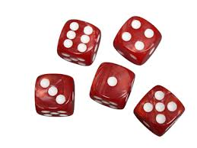

Slide 9




Slide 10
NETTLES FLIES TO RIGHT
1 AWAY
BASES EMPTY

Slide 11
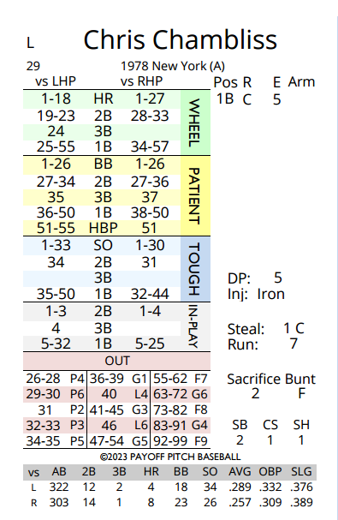

Slide 12


Slide 13



Slide 14
CHAMBLISS SINGLES
1 AWAY
RUNNER ON FIRST

Slide 15
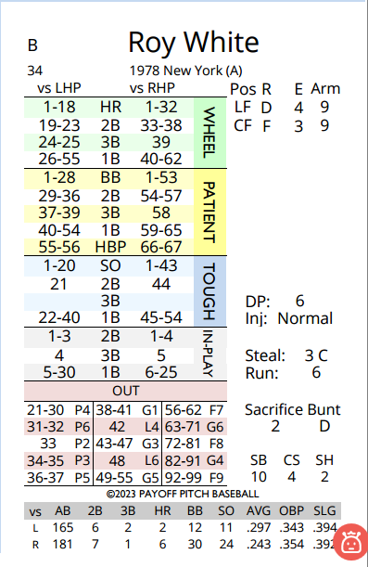

Slide 16


Slide 17



Slide 18
WHITE FIGHTS OFF
GOOD PITCH, SINGLES
1 AWAY
RUNNERS ON FIRST
AND SECOND

Slide 19
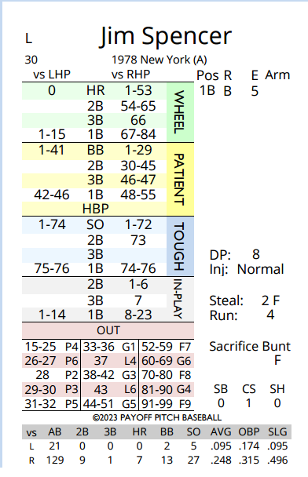

Slide 20


Slide 21



Slide 22
SPENCER FLIES TO LEFT
2 AWAY
RUNNERS ON FIRST
AND SECOND

Slide 23
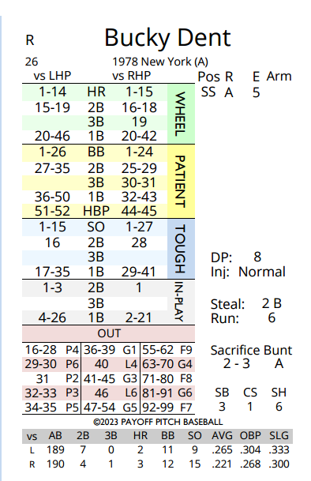

Slide 24


Slide 25



Slide 26
DENT FLIES TO LEFT
INNING OVER
RED SOX LEAD 2-0

Slide 27
WHAT WOULD HAVE HAPPENED NEXT???
Yankees rally anyway – just later and with possibly a different “hero”?
Red Sox win…and go on to face Dodgers in the 1978 World Series?
That’s why we play the game…

