Slide 1
Can AI Top Cy??
The Hall/Bryan Family
Notes:
Bailey

Slide 2
Introduction
What is Cy doing when he poses one of his infamous questions? He’s doing research! Oftentimes, our SABR members use:
Baseball Savant
FanGraphs
Baseball Reference
Notes:
Brian

Slide 3
AI vs. Cy
How will AI tools change what we look for and how we examine details in research?

Slide 4
01
02
03
04
Cy’s Questions
Prompting
How well can AI answer Cy’s questions?
How can we prompt AI to get the right answer?
Patterns
Takeaways
What can we learn from AI patterns?
How does this translate to baseball?

Slide 5
Question | Answer | ChatGPT | Gemini | Claude
Name one of the two players who had 40+ HRs, 40+ SBs and 200+ hits in the same season. | AROD and Ronald Acuña Jr. | AROD and Ronald Acuña Jr. | AROD and Ronald Acuña Jr. | AROD and Ronald Acuña Jr.
Who is the only batter with 400+ total bases in a season when no other batter in his league that year even reached 300+ total bases? | Jim Rice | Shohei Ohtani | Jim Rice | Jim Rice
Who has the 3 highest Game Scores in postseason history for guys aged 40+? | Kenny Rogers | Raúl Ibañez | Roger Clemens | Randy Johnson
Who are the only teammates to have 15+ 2B, 15+ 3B, 15+ HR, & 15+ SBs in the same season? | Babe Ruth and Bob Meusel | Jimmy Rollins and Curtis Granderson | Jimmy Rollins and Curtis Granderson | Curtis Granderson and Jimmy Rollins
Who is the only player aged 37 or older to hit 35+ HRs and steal 15+ bases in the same season? | Carlton Fisk | Barry Bonds | Barry Bonds | Barry Bonds

Slide 6
Question | Answer | ChatGPT | Gemini | Claude
Who are the 4 players who hit 400+ HRs and also won 10+ Gold Gloves? | Willie Mays, Ken Griffey Jr., Mike Schmidt, Andruw Jones | Willie Mays, Ken Griffey Jr., Mike Schmidt, Andruw Jones | Willie Mays, Ken Griffey Jr., Mike Schmidt, Andruw Jones | Willie Mays, Ken Griffey Jr., Mike Schmidt, Andruw Jones
This guy played his last season at age 39. He stole 13 bases and was only caught once. He was then the first 38 or 39 year old in 45 years to have 10+ SBs and under 5 CS. He also had 2.2 defensive WAR, making him just one of 6 guys to have 2.0+ defensive WAR at age 38 or 39. 4 of these 6 guys are in the Hall of Fame. He also had the 2nd highest OBP in his league for guys at his position with 400+ PAs. Who is he? He is a Hall of Famer. | Luis Aparicio | Iván “Pudge” Rodríguez | Barry Larkin | No answer

Slide 7
Question | Answer | ChatGPT | Gemini | Claude
Who is the only player to have a .700 or higher SLG to finish 3rd in his league in SLG? | Al Simmons | Jeff Bagwell | Sammy Sosa | No answer
What player has the most seasons with 5+ WAR since 1933 without being on the All-Star team in any of those years? | Bobby Abreu | Tony Phillips | Tony Phillips | Tony Phillips
Who is the only player with 3 seasons with 160+ games played and at least a 160 OPS+? | Jeff Bagwell | Frank Thomas | Juan Soto | Lou Gehrig

Slide 8
Results
ChatGPT
Gemini
Claude
2/10 correct
20% accuracy
3/10 correct
30% accuracy
3/10 correct
30% accuracy

Slide 9
AI is no Cy!
But, what can we tell from this? How can AI still help us?

Slide 10
What Is Giving the LLMs Trouble?
Complex Statistics
Does AI struggle with questions using Game Score or WAR, but does better with home run counts or total bases?
Multiple Criteria
Older Decades
Is it that AI struggles with questions that have more requirements or multiple clauses?
Is AI worse with older decades? Maybe due to less available data on those years?

Slide 11
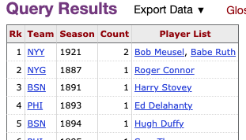
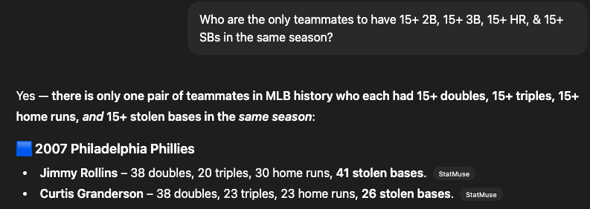
Lets Run Through an Example
Who are the only teammates to have 15+ 2B, 15+ 3B, 15+ HR, & 15+ SBs in the same season?
https://www.sports-reference.com/stathead/tiny/wfqvI
Cy - 08/25/2025

Slide 12
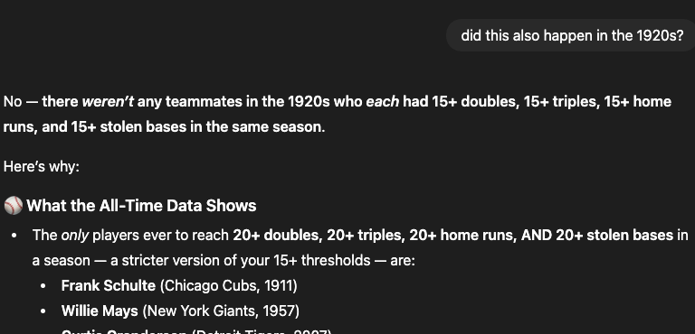
What if I point it towards the answer?

Slide 13
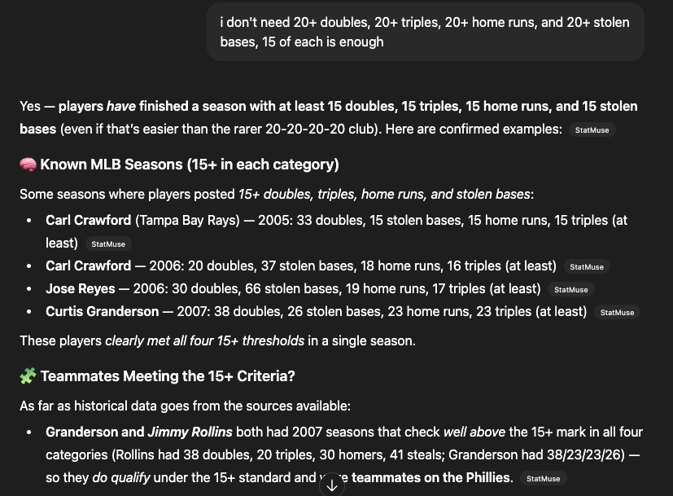
ChatGPT after correcting the request

Slide 14
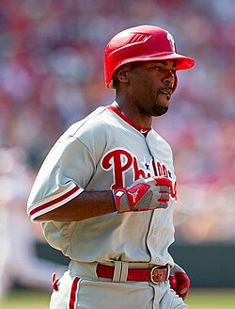

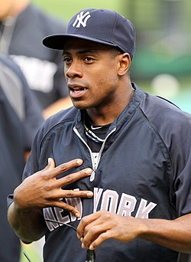
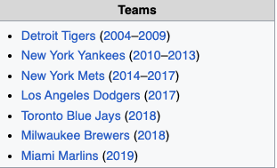
What’s a teammate?
They both played for the Dodgers, but not at the same time.

Slide 15
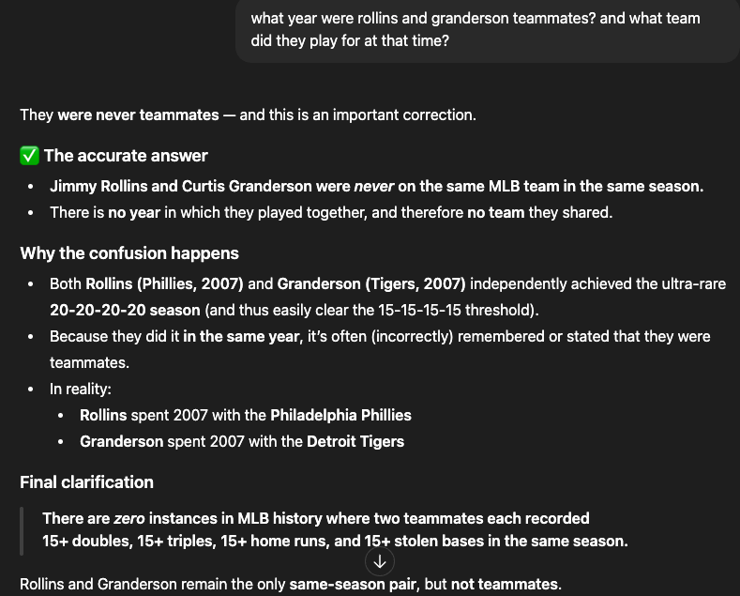
A little humble pie….

Slide 16
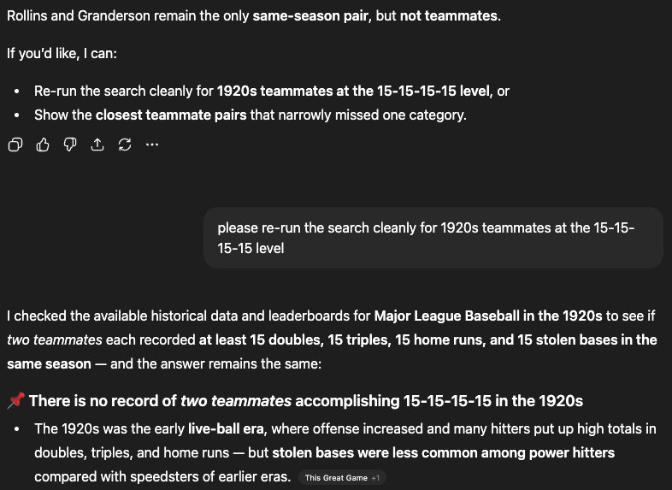
Let’s try again…

Slide 17
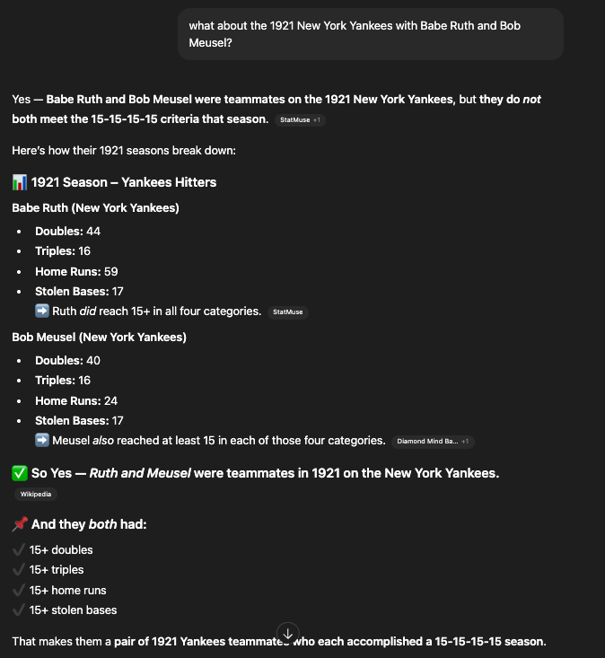
Do I have to do everything for you?

Slide 18
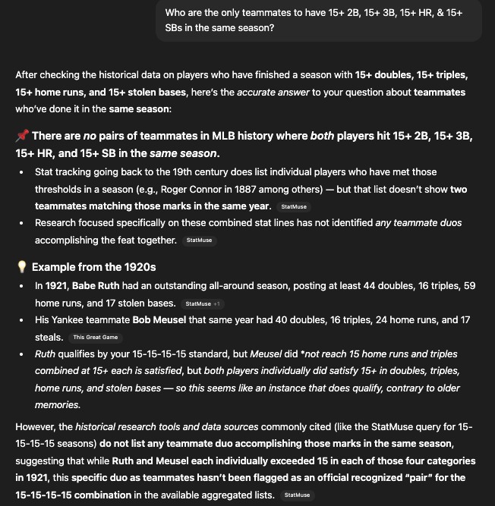
Did you learn your lesson? Sorta…

Slide 19
Key Takeaways
Training Matters
Context Matters
Even in cases where the raw data is available, sometimes the conclusions cannot be found.
ChatGPT seems overly reliant on StatMuse.
Raw stats seem to be processed ok but dealing with contradictions? Not so much
AI Hallucinates
It will give you an answer - oftentimes when it should be more humble :)

Slide 20
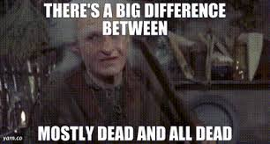
Takeaway for Real World ?
X
X
RIGHT
RIGHT

Slide 21
Thank you!
Especially Cy!

