Slide 1

Addressing Challenging Behavior in Dementia
Lori Nisson, MSW, LCSW

Slide 2

Objectives
Identify common behavioral changes
Recognize common causes or trigger behaviors
Learn effective strategies to minimize behaviors
Understand when it is necessary to utilize medical resources

Slide 3

Sensitivity
Dementia affects one’s ability to manage their environment, communicate and behave conventionally
Behavioral changes are part of the disease process
  Typically, not volitional
  Person can no longer function at previous level
Requires caregivers to anticipate needs
  Implement care with compassion and empathy
Balance between person’s rights/ self determination and safety

Slide 4

Purpose
Behavior has a purpose
  Often signals an unmet need
Behavior is triggered by an impetus
Caretakers may have to act as a detective
Goal is to assess what caused the behavior and try to alter the pattern
By utilizing a different approach, we work toward a different outcome
Notes:
Family Caregiving Alliance 2011

Slide 5

Understanding Behaviors
80% of those with dementia will experience some behavioral disturbance
Most behaviors occur in moderate stages of Alzheimer’s disease
  Earlier in Lewy Body Dementia and Frontotemporal Dementia
Often emotional symptoms are seen in early stage
  Loss, frustration, depression, & anxiety
Symptoms may worsen as the day progresses
Notes:
The most recent didactics from Michele are available in the Didactics folder within the Cohort 17 directory. Presentations for Session 9 and Session 12, originally presented by Helle. After reviewing both, Helle did not make any additional edits.

Slide 6
Progression
As the disease progresses
  Behavioral changes follow
  Functional decline parallels
Solutions that are effective today may need modification
Key to managing difficult behaviors
  Creativity and flexibility
  Shifting our thinking
  Stepping out of old patterns of communication
    Counter-intuitive
Early
Middle
Late

Slide 7
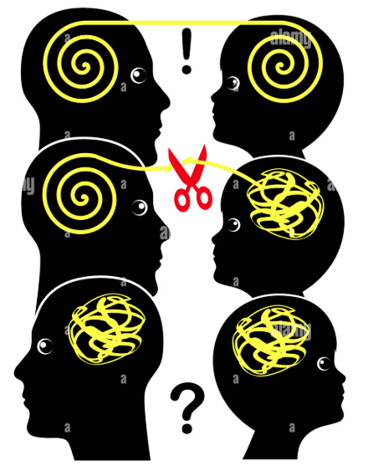
Understanding behaviors
Dementia impacts a person’s ability to:
  Manage emotions
  Carry out daily living tasks
  Navigate the environment
  Communicate conventionally
  Handle change & stress
  Make sense of the world

Slide 8

Therefore, behaviors are…
Actions meant to communicate:
Needs, feelings, signals
Messages with personal meaning

Slide 9
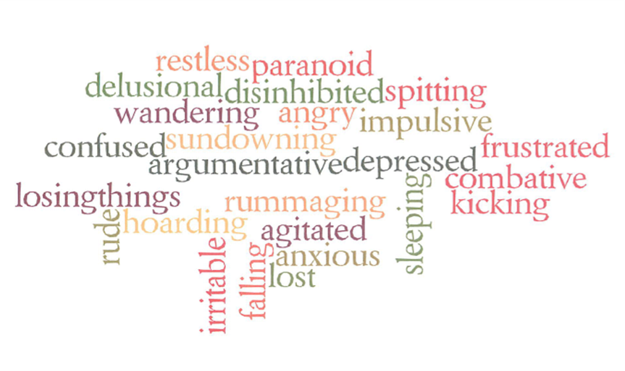
What you might see

Slide 10

Look for the trigger
Behaviors typically have a cause
Ask yourself:
  Why did this happen?
  What has changed?
  What are they trying to tell me?
Once identified
  GOAL is to help caregiver eliminate the trigger or help person navigate more effectively

Slide 11
Common environment triggers
Misperception - illusion
Change in Routine
  Daily structure, caregivers
  Holidays
Providing care
    Puts caregivers in a potentially intrusive position
    Person can feel their privacy / independence being invaded
Environment
  Too much / too little stimulation
  Any change in environment
  Not enough activity/ too much activity
Notes:
Misperceiving a rug appears to be black hole
Holidays
Cold, vulnerable and exposed from a shower
Lack of privacy, lack of control, feeling cold
Fine balance between rest periods and activity
Build or shape previous interests
Try new ones involving senses: music, hand massage, nature walks, listening to birds

Slide 12
Common physical triggers
Confusion
Pain/ Illness
  May not be able to verbalize the pain sensation; expressed through actions
  Urinary tract infections/virus/ pneumonia/constipation
  Side effects of new medication/anesthesia
Unmet Needs
  Fatigue
  Hunger or thirst
  Toileting needs
  General discomfort, satisfaction, distress

Slide 13
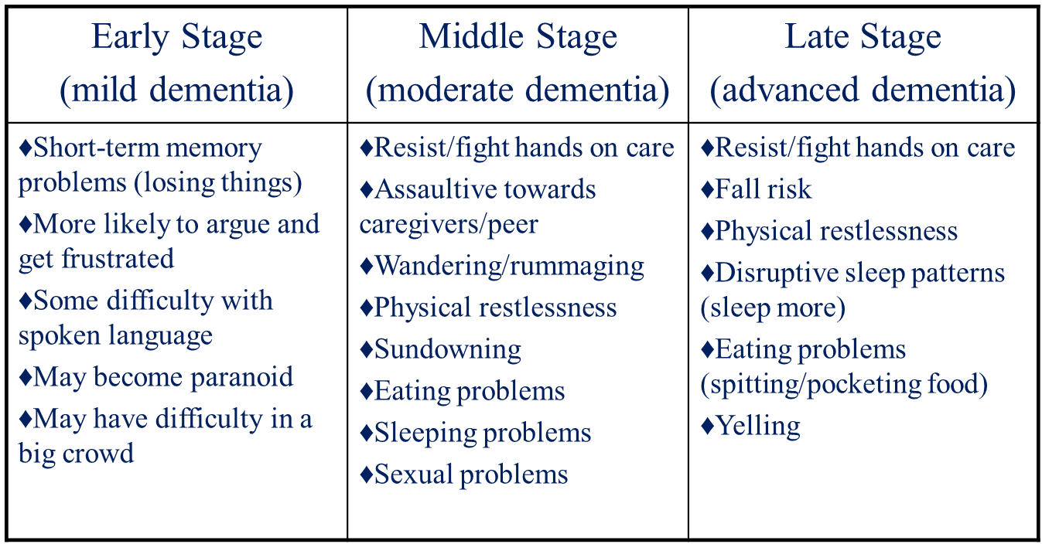
Common Behavior Problems
Notes:
Early stage: mood driven: apathy, depression
Moderate: anxiety, agitation, expression through behavior
Advanced, discomfort.

Slide 14

How to approach
Address gently by their preferred name
  If they are angry - use Mr., Mrs., Ms.
Approach the person slowly from the front
Keep communication simple as they may become overwhelmed
Non-verbal communication is important to successful interactions
  Maintain eye contact
  Be aware of your body language - maintain an open posture
  Nod of approval to establish a positive rapport
Speak slowly with low tone
  Low voice can help de-escalate
Pause to offer time to process
  Expect responses to be delayed – they will need time to process and produce an answer
Notes:
CARE TIPS: Avoiding Arguments

Slide 15

Ask simple questions
Speak calmly and clearly
Avoid multipart questions
  Person easily overwhelmed
Try open-ended questions
  Then try a yes/no or one-word answer questions
Be patient when waiting for answers
Try rephrasing
Live in the person’s world
  Avoid correcting
  Redirect as necessary
If your question is not working, make a connection to another event, place, or time
Avoid Arguments
  Agree, apologize, distract or defer
Notes:
CARE TIPS: Avoiding Arguments

Slide 16

Inadvertent escalation techniques
Correcting
Reasoning
Arguing
Reorientation
Always telling the truth
Over-explaining
Exposing frustration or anger
Unrealistic expectations or demand
Finger pointing or scolding
Retraining

Slide 17

Active de-escalation techniques
Provide plenty of rest periods
Alternate with periods of activity
Caregiver can modify past activities and shorten duration
Maintaining a routine
Agree, apologize, distract
Modify our reactions, understand disease, increase patience
Accept person as they are in this moment
Notes:
Activities
Example: Golfing
Example bird feeder:
Example: Baking
Example: Dancing in the living room

Slide 18

Studied interventions
Massage or therapeutic touch
Playing preferred music (live, speaker or headphones)
Use of lavender oil or lemon balm/Melissa leaf oil (on pillow, diffuser)
Sounds of nature: birds chirping, ocean waves, white noise
Pleasant activities
Interaction with pets
Simple social interactions (photo albums, photo slide show)
Favorite foods
Physical activities
Notes:
FROM LIT REVIEW: American Geriatrics Society(2010).A guide to dementia diagnosis and treatment.
Garland, K., Beer, E., Eppingstall, B., O’Connor, D. (2007) A comparison of two treatments of agitated behaviors in nursing home residents with dementia: simulated family presence and preferred music. American Journal of Geriatric Psychiatry15(6)514-521.

Slide 19

When to involve medical providers
Often behavioral interventions can minimize most behavioral challenges
If there is an abrupt change in behavior, mental status or function
If there is potential pain or infection
If psychosis hallucinations, delusions or paranoia are not redirectable
Sudden or severe increase in confusion could be a sign of delirium, which is a medical emergency.
If there is violence
If everything team and caregiver have tried has not worked

Slide 20
Resources
Alzheimer’s Association
  www.alz.org
  24-hour helpline 800-272-3900
  Medic Alert + Safe Return
Banner Alzheimer’s Institute: Phoenix, Sun City, Tucson
  www.BannerHealth.com/Alzheimers
Dementia Friends America
  www.dementiafriendsusa.org
US Aging: National Association of Area Agencies
  www.usaging.org
  Maricopa AAA www.aaaphx.org

Slide 21
