Slide 1
MLB All-Stars who played professionally at
Dell Diamond
By W. Andrew York
SABR Hornsby Chapter
Aug. 22, 2026

Slide 2
1. This 10-time All-Star (between 1986 and 2005) drew the largest attendance in Dell Diamond history with 13,475 watching him start on the bump in 2006. He pitched 5.2 innings and took the win.
Initials: R C

Slide 3
2. In 2024, this 6-time All-Star pitcher (between 2013 and 2021) appeared in 4 games for the Express (not all in Round Rock). At one of the games at the Dell, he faced off against another All-Star (just in 2015) rehabbing for Tacoma. The visiting All-Star received the win; both having already won the Cy Young Award.
Initials: M S
Initials: D K

Slide 4
3. This 9-time All-Star outfielder (between 1995 and 2008) tried a comeback in 2013 but only lasted with the Express for 30 games (not all at the Dell). To do so, he had to conform to team rules including trimming his signature wild hairstyle and moderating his often-prickly interactions with fans. He was known for his power, for much of his MLB career he tallied over 30 homers each year (the most was 45).
Initials: M R

Slide 5
4. In the AA Era of the Express, this Texas native, a 2001 and 2010 All-Star pitcher, appeared in 2 games in 2004 (at least one in Round Rock). At the time he was part of an investor group looking at taking a minor ownership share in the team. He did start in 8 World Series between 1996 and 2009.
Initials: A P

Slide 6
5. Also in the AA Era, this 5-time All-Star infielder (between 1999-2005) played 3 games for the team in 2003 (at least one in Round Rock). This Austin area resident, and minority owner of the Express, won a Silver Slugger Award 4 times between 2000-2005 and is in the Baseball Hall of Fame.
Initials: J K

Slide 7
6. This 6-time All-Star infielder (between 2012 and 2018) rehabbed in Round Rock for several games in 2019. He was noted for his enthusiasm and team support, even after being removed from the game (stayed in the dugout and cheered the team, hanging on the dugout rails and shouting encouragement – a team player!). He was Sporting News MLB Player of the Year in 2016 and 2017.
Initials: J A

Slide 8
7. This 6-time All-Star (between 2001 and 2011) had several rehab stints in 2005, 2010, and 2013 with the Express. Known to be a power hitter (366 homers over 15 years), it was awkward during his last rehab stint when he hit an inevitable home run. At that time, the fan “Home Run Dollars” initiative (holdover from the AA Era to collect dollars for home runs to support the player) hat-passers were a bit hesitant to collect for this highly paid player. They did, but the take was small. He is in the Astros Hall of Fame and appeared in 2 World Series.
Initials: L B

Slide 9
8. This 2005 and 2006 All-Star pitcher had a combined 22 starts with the Express (not all at the Dell) in both the AA and AAA Eras (2000, 2012 (rehab)). He is a member of the Express Hall of Fame and was Sporting News Rookie Pitcher in 2001.
Initials: R O

Slide 10
9. In 2024, this 3-time All-Star pitcher (between 2015 and 2019) started 2 games in the Dell while on rehab. He collected 2 Cy Young Awards since his first MLB appearance in 2014, after being named both the BWA and Sporting News Rookie of the Year.
Initials: J d

Slide 11
10. This 7-time All-Star pitcher (between 2011 and 2023) extended his career last year by signing a minor league contract with the Rangers. He relieved in the Dell 10 times before being picked up by a major league team for the backside of the 2025 season. His pre-pitch windup was like nothing I’ve seen before! He is 5th on the All-Time Save record list for MLB.
Initials: C K

Slide 12
11. This first baseman had his AAA debut for Oklahoma but in 2011 played 48 games, hitting 24 homers, for the Express (not all at the Dell). He became a 2013 All-Star while hitting 53 homers with the Orioles.
Initials: C D

Slide 13
12. This 3-time BWA Cy Young Award winner and 8-time All-Star pitcher (between 2011 and 2025) had a 2024 rehab start for visiting Oklahoma City. In 2014 was the BWA MVP and Sporting News ML Player of the of the Year.
Initials: C K

Slide 14
13. Recently an itinerant (different teams each of the past three years through free agency), mostly hot-corner, infielder appeared at the Dell while on a rehabbing stint in 2021 for a visiting team. Also appeared in 2016 as part of the visiting Fresno team days before his MLB debut. All-Star appearances in 2018 (recognized as the MVP) and 2019.
Initials: A B

Slide 15
14. Chosen four-times as an All-Star (2008-2011), a two-time BWA Cy Young winner (2008-2009) and Sporting News Pitcher of the Year (also 2008-2009), this pitcher tried a comeback attempt with the Express in 2018, two years after his last MLB appearance. However, it didn’t lead to a return to the show, lasting only about a month with 10 appearances, 6 in Round Rock.
Initials: T L

Slide 16
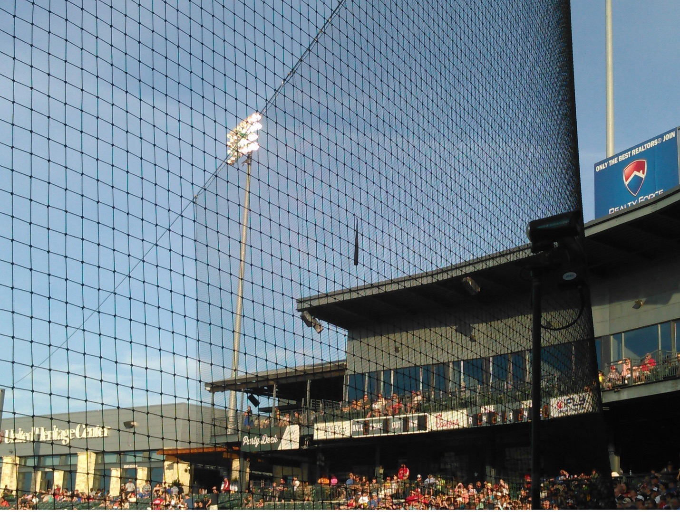

Slide 17
15. On June 5, 2016, the year after his MLB debut, this 2019 and 2021 All-Star outfielder shattered his bat in a plate appearance. The barrel wedged itself firmly in the net behind the plate. Efforts to dislodge it were unsuccessful and play was resumed with the barrel hanging there for the remainder of the game. In 2021, he led the AL in number of bases on balls and in strikeouts. In 2025, he decided to try for an MLB comeback, relying on his high school roots, in an effort to return in a pitching role.
Initials: J G

Slide 18
16. This reliever, in a closing role lately, has appeared in dozens of games for the Express since 2021. He received his first All-Star nod this year and collected a Hold for .1 innings on the bump.
Initials: J L

Slide 19
17. Chosen for the 2025-2026 All-Star rosters, this pitcher made a single rehab start in Round Rock for Oklahoma City in 2024 while returning from 2+ month stint on the IL, throwing 2 innings of 1-run baseball. He was the 2025 World Series MVP. For Round Rock, Kumar Rocker had his AAA debut throwing opposite him.
Initials: Y Y

Slide 20
18. A 5-time All-Star (every year between 2008 and 2012), and 3-time Silver Slugger Award winner, played many games at the Dell while on his way up to the majors -- plus a 2015 rehab stint. In the Bigs, 5% of his plate appearances were home runs while his strikeout percentage was 24%.
Initials: J H

Slide 21
19. The 2022 All-Star had a number of appearances on the bump at Dell Diamond before his promotion to the Bigs. He’s pitched for 7 teams since 2019 including a return to his first MLB team in 2022-23. This player also has 1 World Series appearance.
Interestingly, while at Petco Park a few years back, I had a conversation with a Padres player support staffer who, in his previous employment with Texas, had helped in this current pitcher in his transition to the major leagues. We swapped stories and memories.
Initials: M P

Slide 22
Special thanks to Rylan Kobre, Manager of PR & Broadcasting for the Express, for his assistance in providing a review, suggestions and other ideas to improve the quiz.
Any errors are my responsibility. The reviewers caught several, but I’m sure there are more!
Please send any feedback, corrections and comments to wandrew88@gmail.com

Slide 23
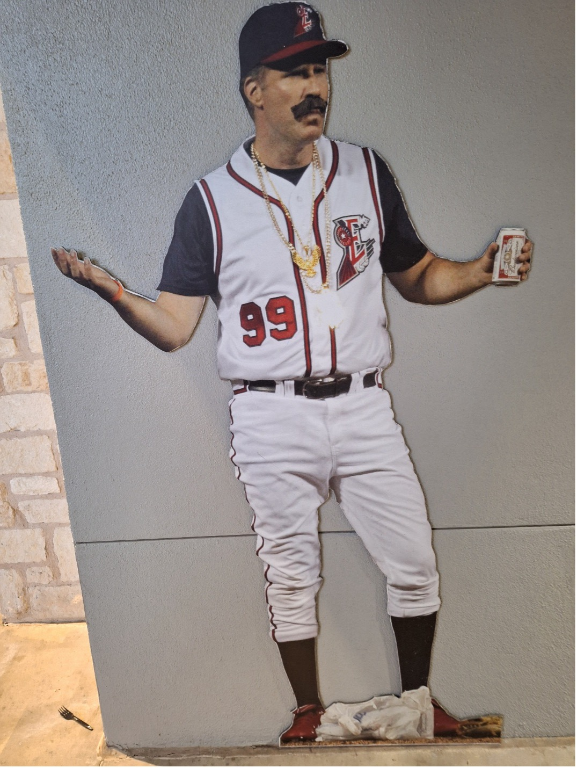
Tie breakers
1. In 2010, to promote a charity golf tournament, Will Ferrell had a mound appearance before 10,000+ fans. This was a between innings skit, as a bad-boy pitcher just “signed” from the Mexican leagues. What was his colorful name? Note – you can see his outing on YouTube including Budweiser drinking on the mound and other antics. It is memorialized at the Dell in a display (partially shown above) opposite the Season Ticket Holder entrance behind section 117.

Slide 24
2. This should-a-been an All-Star played his last professional games as a player catching (with a few infield cameos) for the Express in 2011. Later, he managed a World Series appearing team. Note – I chatted with him in the Intel Club once after his retirement. If I’d known of his future, I’d have spent more time talking baseball with him!
Initials: K C

Slide 25
3. Which of the following team names did the Express actually play under for one or more games: +1 point for each correct guess, -5 points for an incorrect guess:
‘34s Fire Ants
Armadillos Grackles
Black Senators Jackalopes
Briskets Round Rock Donuts
Chupacabras Train Bandits

Slide 26
4. Which 2022-2023 Express pitcher (not an All-Star) was called out by, presumably visiting, fans for being favored in relieving duties because he was “Nolan Ryan’s son”. He is currently in the Dodger’s organization. Note – At the time, Ryan’s sons were over 45 and part of the Ryan-Sanders management team with his college aged grandson part of the Express staff.
Initials: R Ryan

